Slide 1
Beyond Silverbacks: Strengthening African Conservation Leadership
Africa Biodiversity Collaborative Group
November 22, 2016

Slide 2
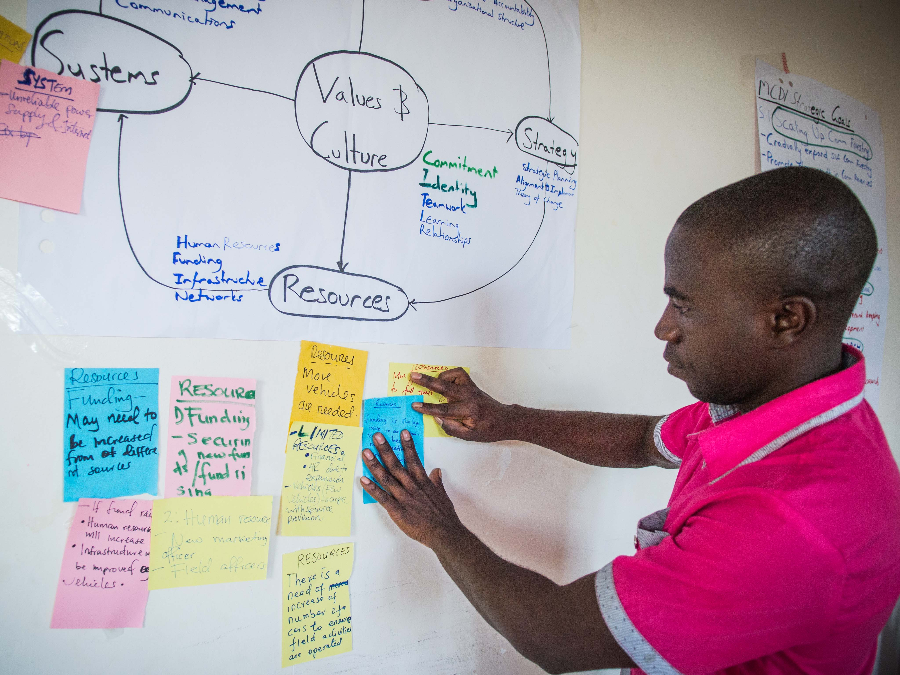
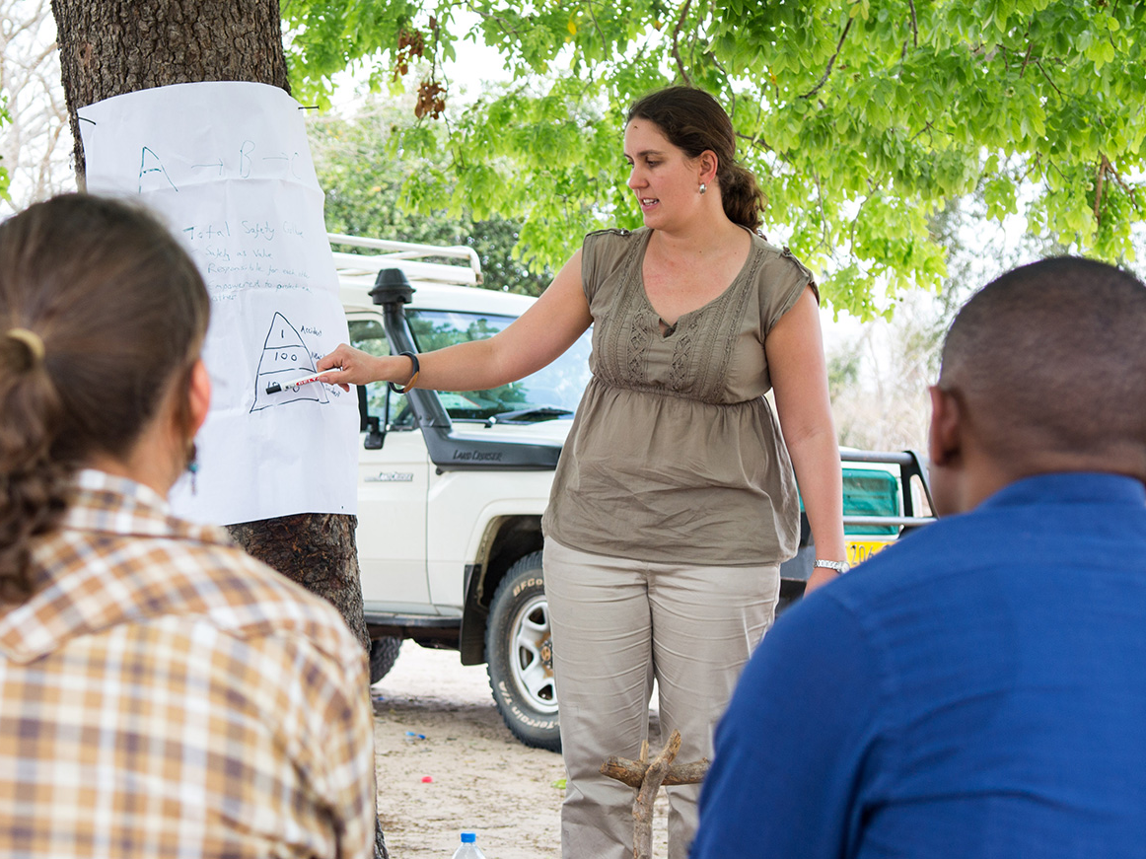
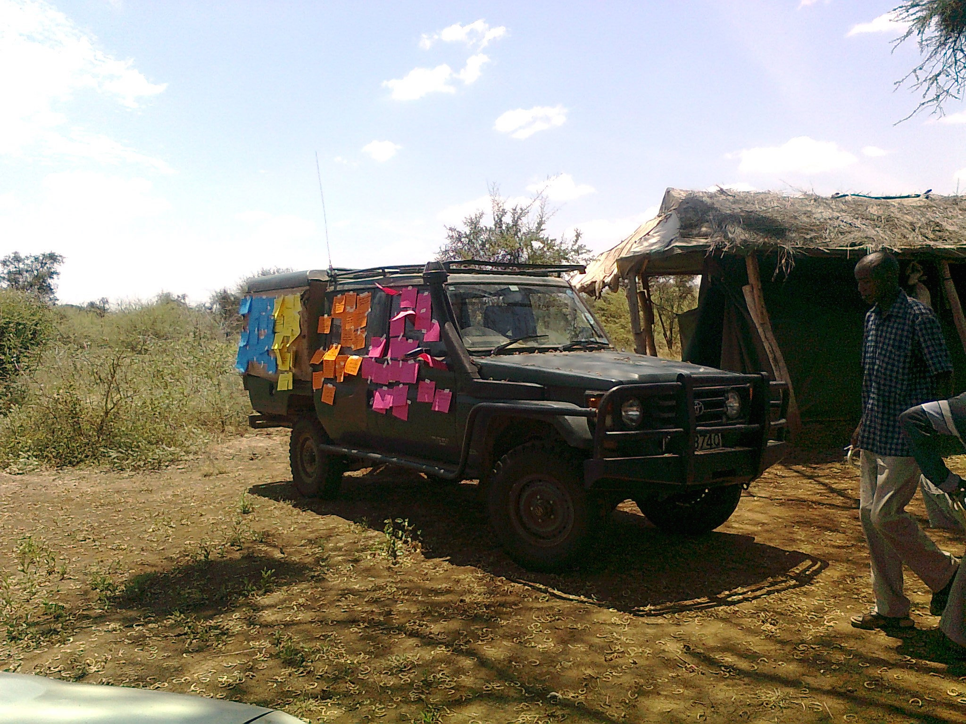
Notes:
Maliasili Initiatives’ job is to help African organizations overcome those challenges, capitalize on their potential, and fulfill their missions.
We provide customized organizational development tailored to each organization,

Slide 3
Strong and Capable Leaders
Effective Organizations
Conservation Impacts

Slide 4
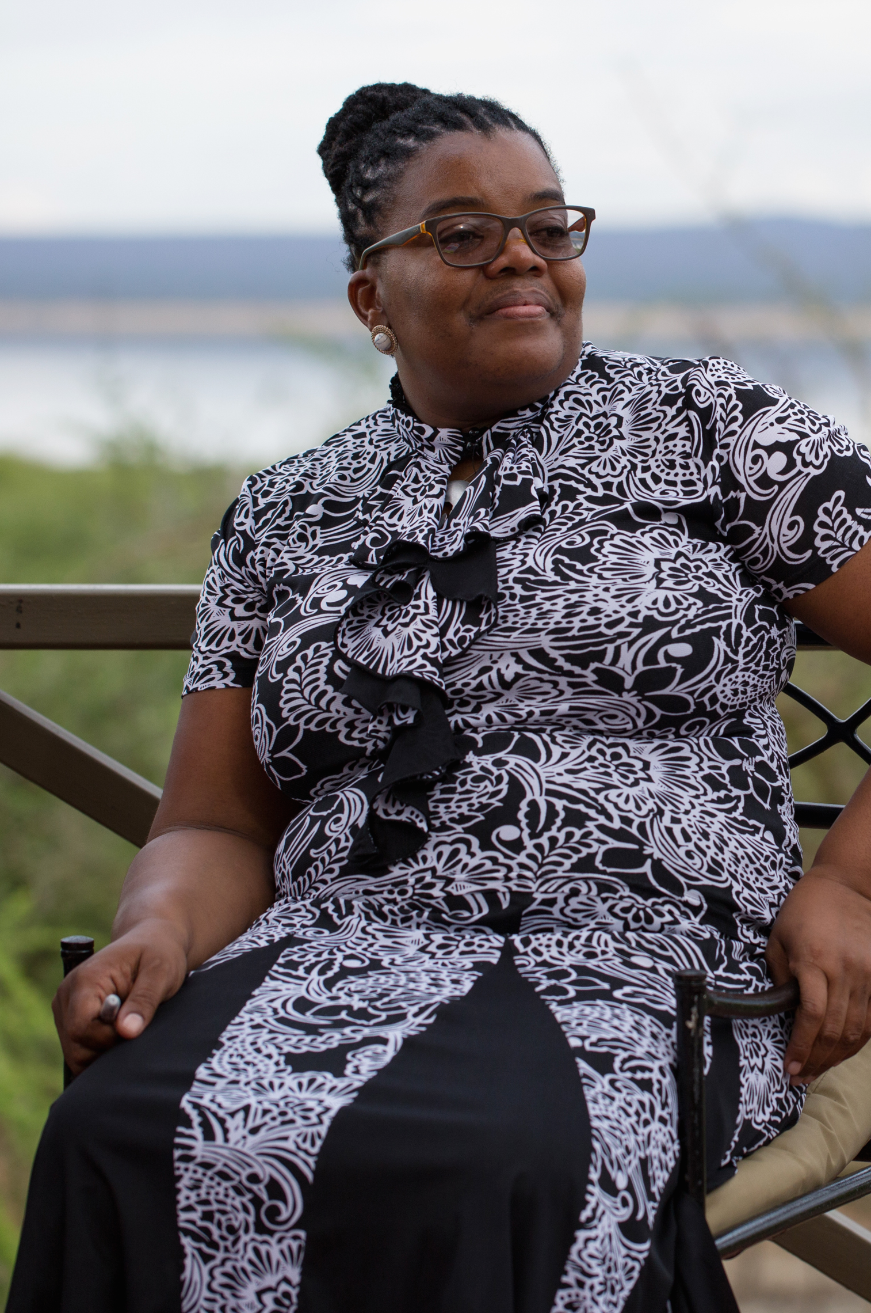
From Silverbacks to Systems Leaders

Slide 5
Framework: Systems Leadership
Systems Leadership (Collaboration)
Organizational Leadership (Management)
Individual Leadership (Personal)
Customized and adaptive curriculum
External tools and methods with peer learning approach
Two week-long sessions

Slide 6
Participants

Slide 8
Notes:
Gratifying to see participants take content and apply in a short period of time- real-time experimentation and learning.

Slide 10
Notes:
CITES- NACSO and KWCA

Slide 11
Summary Content
AUGUST
Embodied Leadership
4 ways of talking and listening
Aikido & Prioritization
MBTI and Strengths Finder
Awakened Mind/Brain Waves
Intimate & Strategic Balance
Tall Ships/Teams and Leading
Change 5 things/Resistance
Work-out and 20% reductions
Re-entry
NOVEMBER
Learning Journey – August
The Vortex – centered/chaos
Mindfulness/Home Base
Conflict Styles/MBTI
Building/Managing Teams
Form/Storm/Norm/Perform
Collaboration/Complex Challenge
Collaboration Constellation
Resistance to Change

Slide 12
Participant Observations
This training started with each of us as individual, where we are and how we fit into this. Forced us to step away from our roles and think about who we are to our orgs and who we are to ourselves.
It is rare for someone to talk to you for a week about something that improves you as a person.
There is such a pool of great ideas and experiences, and a forum to interact…we all need to commit to do things together so that the network continues.
This is the beginning of something very big in conservation – a network that brings us together.

Slide 13
Key Lessons
Cross-cultural resonance
Myers-Briggs Personality Type
Concepts of Leadership and self-awareness
Time management and prioritization
Strategic vs Intimacy Balance
Power of the cohort approach
Adaptive facilitation

Slide 14
Next Steps
Package content into leadership reference tool
Finalize curriculum summary
Foundations developed for a potentially important new network of leading African conservation organizations
Entry-point for external mentor networks
Basis for collection action and dialogue on key systemic challenges
Integrating organizational and technical issues

