Slide 1
USING EVIDENCE MAPPING FOR CONSERVATION AND DEVELOPMENT
Samantha Cheng
NCEAS, University of California, Santa Barbara
17 November 2016
Notes:
- Add relevant logos

Slide 2
Notes:
Today, we are faced with conservation and development challenges at all scales. Globally, we face ecosystem alterations from climate change that will dramatically alter species ranges, including our own.

Slide 3
Photo by © Kristin Harrison & Jeremy Ginsberg
Notes:
We wrangle with the complexities of ensuring food security while ensuring sustainable harvest from our quickly dwindling natural resources.

Slide 4
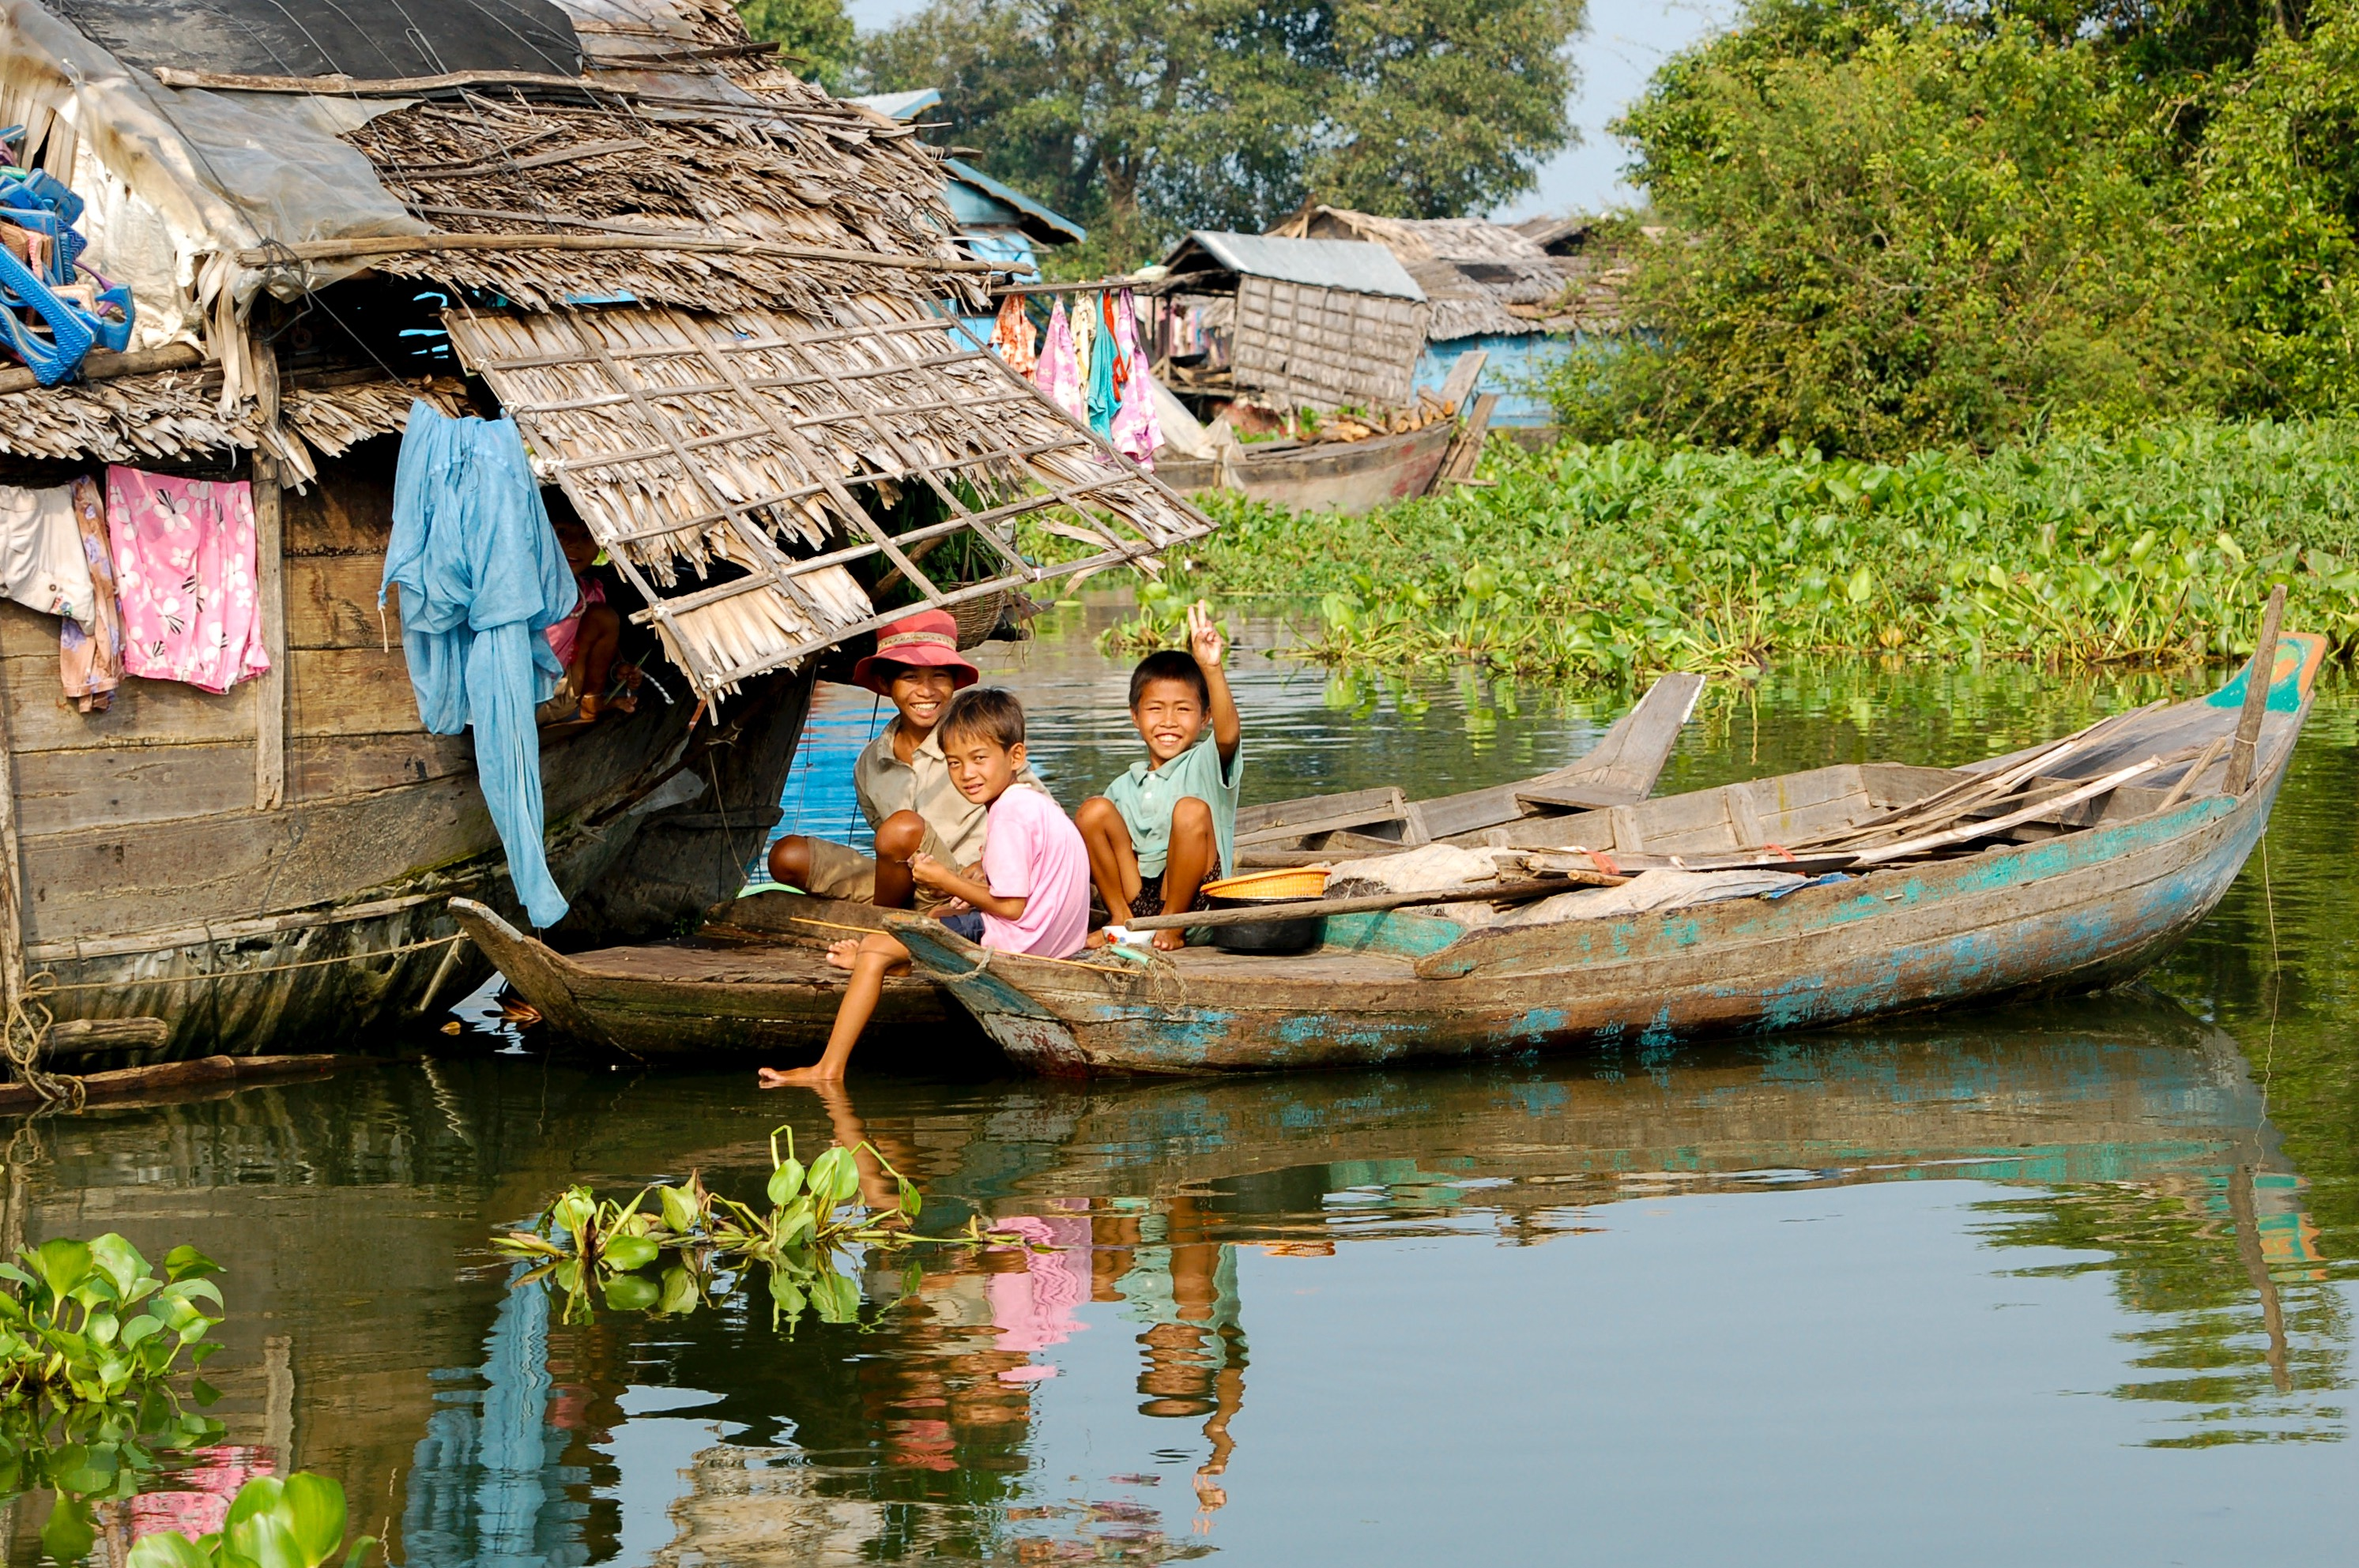
a
Photo by © Conservation International/photo by Tracy Farrell
Notes:
We try and balance supporting the livelihoods of the poor while protecting habitats and preserving biodiversity.

Slide 5
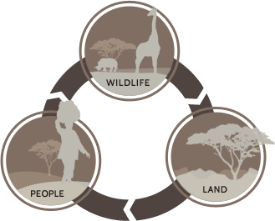
?
?
?
Notes:
Practitioners and policymakers face decisions regarding what actions they should take to achieve objectives and most will involve some level of uncertainty of outcome. As the desired outcomes from conservation are becoming increasingly complex – in that we are aiming to achieving win-win outcomes for both natural ecosystems and people as well as aiming to act at the ecosystem and global scales – how does a decision-maker choose between possible alternative actions? For conservation practice to be effective, actions need to be supported by the best available evidence which includes information on what does and does not work, under what conditions and in particular as we try and achieve co-benefits for nature and people - considerations of any trade-offs.

Slide 6
“EVIDENCE-BASED CONSERVATION”
HOW MANY PEOPLE USE EVIDENCE IN DECISION MAKING?
139
2100
ARTICLES
ON IT
ARTICLES
CITING THEM
Notes:
The importance of evidence-based decision-making is clear and broadly accepted. Judging from the literature alone – there has been numerous calls to engage in more evidence-based conservation, with the call being echoed around the sector. However, despite the widespread attention on it – how many people are actually using evidence to make decisions?

Slide 7
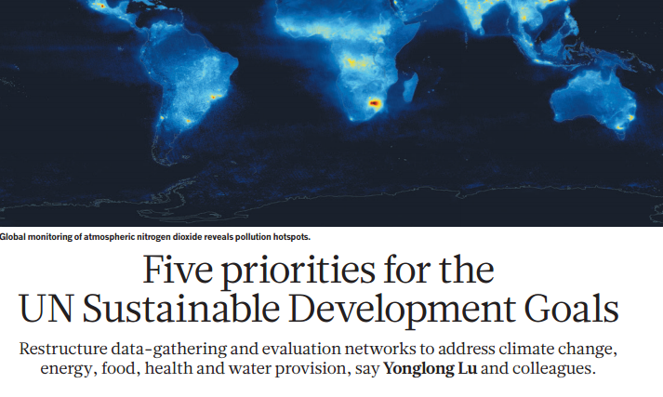
TRACKING PROGRESS REQUIRES
MONITORING, REPORTING & EVIDENCE
Lu et al. 2015. Nature. April 20th
Notes:
This is particularly critical as the world takes on the recent UN Sustainable Development Goals which explicitly target sustaining natural ecosystems in order to address climate change, provision of energy and water, ensuring food security and improving global health. In order to track progress towards these goals however, we need empirical evidence documenting both impacts and mechanisms by which they are achieved. Despite heavy investment in these linkages, much of the evidence underlying these assumptions is still lacking or unclear, increasing the risk of investing in actions that don’t work or worse, result in negative consequences. While we know that further research is still needed, we also have decades of conservation research to draw from. Knowing that some evidence out there, what are the barriers to finding it and using it?

Slide 8
EXPERIENCE-BASED VS. EVIDENCE-BASED
Respondents from UK conservation community indicate desire to use evidence but:
lack of time find it
lack of support framework to quickly sort and evaluate evidence
lack of access
Experience-based
Evidence-based
modified from Pullin et al. 2004
Notes:
An illuminating example from Andrew Pullin from the Collaboration for Environmental Evidence and collaborators found that while there is a strong desire within the surveyed UK conservation community, to use more evidence in decision making, there are multiple barriers to doing so. First, data on the effects of conservation on human well-being is currently scattered across multiple sources, many of which are inaccessible without institutional access. Furthermore, this makes finding relevant information extremely time-consuming, as evidenced by the tens of thousands of potential hits from a simple search. Thus, in the absence of a more targeted and accessible evidence base, they found that most respondents base the majority of decision making based on experience rather than evidence. This study was done in 2004, and …

Slide 9
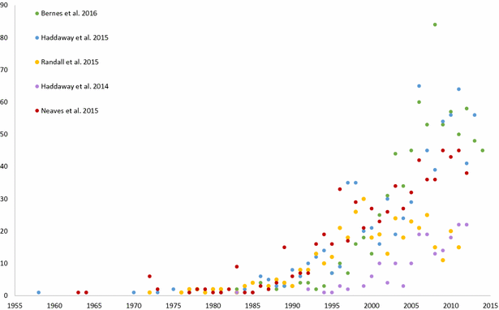
INCREASE IN EVIDENCE BASE
23% increase in evidence base over 2 years on effects of agricultural management on soil carbon stocks
Bayliss et al. 2016
Notes:
In the intervening years since, the volume of information on conservation practice has increased greatly and the rate at which new evidence becomes available is growing exponentially. For example, analysis of publication rates on a very narrow topic such as impact of agricultural management on soil carbon has seen a 23% increase in the overall evidence base just in the last 2 years.

Slide 10
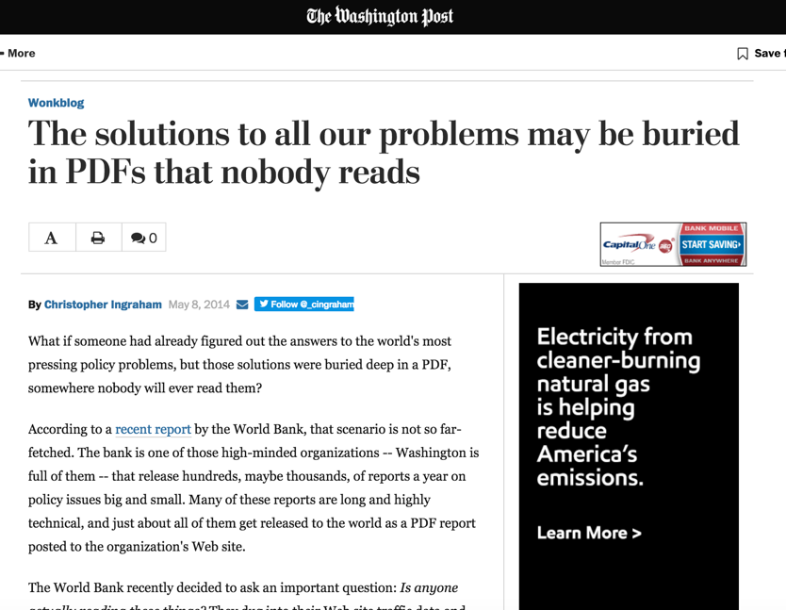
Notes:
Despite this, the articles and reports are still scattered across multiple sources or are inaccessible as papers lie behind a paywall or buried in the electronic archives of an organization. Resulting in a growing, but mysterious evidence base.

Slide 11
HOW DO WE FIND EVIDENCE?

Slide 12
SYSTEMATIC TOOLS FOR EVIDENCE SYNTHESIS
Systematic evidence synthesis as a standard practice in medicine and public health to provide credible information for decision-making
Gilbert et al. 2005
Notes:
To address this issue, systematic approaches are increasingly being applied to synthesis key messages on effectiveness from a broad evidence base. Originating in the medical and public health sector, systematic tools are becoming a standard practice to evaluate the cost-effectiveness of different medical practices in order to provide credible and cohesive information for decision-making, drawing from the total expertise and experience of the vast medical research and practitioner community. The Cochrane Collaboration has been a key player in established accepted methodology for synthesis and ensuring dissemination of results.

Slide 13
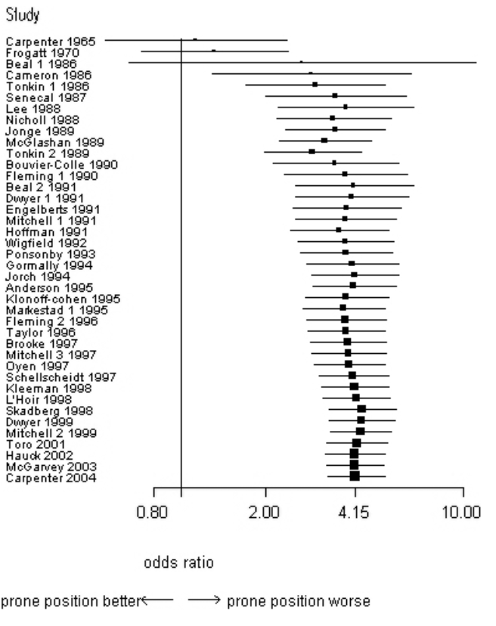
SYSTEMATIC TOOLS FOR EVIDENCE SYNTHESIS
Systematic review on incidence of SIDS from sleeping position
Despite presence on evidence that front-sleeping had significantly higher risks of SIDS, recommendations were not changed until the 1990s
Gilbert et al. 2005
Notes:
An example of a systematic approach is in this synthesis of relationship between sleeping position and incidence of sudden infant death syndrome. The study conducted in 2005 found that although substantial evidence was present from 1970 onwards showing that infants sleeping on their front had a much higher risk of SIDS, recommendations on practice were not changed until the 1990s. Had a systematic study been conducted sooner, thousands of infant deaths could have been avoided.

Slide 14
SYSTEMATIC TOOLS FOR EVIDENCE SYNTHESIS
69 Systematic Reviews + 12 Systematic Maps
Notes:
Similarly, systematic approaches are increasingly being applied to environmental management and conservation problems. The Collaboration for Environmental Evidence stands as a leader in providing comprehensive guidelines on how to conduct reviews and maps and an open access journal of resulting publications. Currently, there are 69 Systematic Reviews and 12 Systematic Maps.

Slide 15
EVIDENCE MAPS or
SYSTEMATIC MAPS
Thematic collections of primary research studies and systematic reviews within a sector
A visual graphic that maps the distribution and occurrence of existing evidence using a framework of policy-relevant interventions and outcomes
Snilstveit et al. 2013, James et al. 2016
Notes:
Systematic maps or evidence gap maps have emerged over the last several years, to support these large synthesis efforts. These are thematic collections of primary research studies and systematic reviews within a sector. Specifically, they are a visual graphic that maps the distribution and occurrence of existing evidence using a policy relevant framework of interventions and outcomes.

Slide 16
SYSTEMATIC MAP
VS.
SYSTEMATIC REVIEW
Appraise and synthesize study results
Conduct a “deep dive” into effectiveness or impact of specific actions on defined outcomes
Thorough and unbiased investigation of pathways to impact
Gather and collate evidence on a broad topic
Occurrence and distribution of existing evidence
Notes:
A systematic map differs from a systematic review in a few key areas. You can think of a systematic map as quite literally, a map – that indicates the distribution of information over a broad landscape – much like a bathymetry map details the topology of the seafloor. It will disaggregate a jumble of evidence and tell you where a lot of information exists and where information is lacking. A systematic review on the other hand, is the deep dive to gather fine-scale details on a specific question. Reviews are where we can appraise and synthesis the study results in order to understand which actions were effective for achieving a set of outcomes.

Slide 17
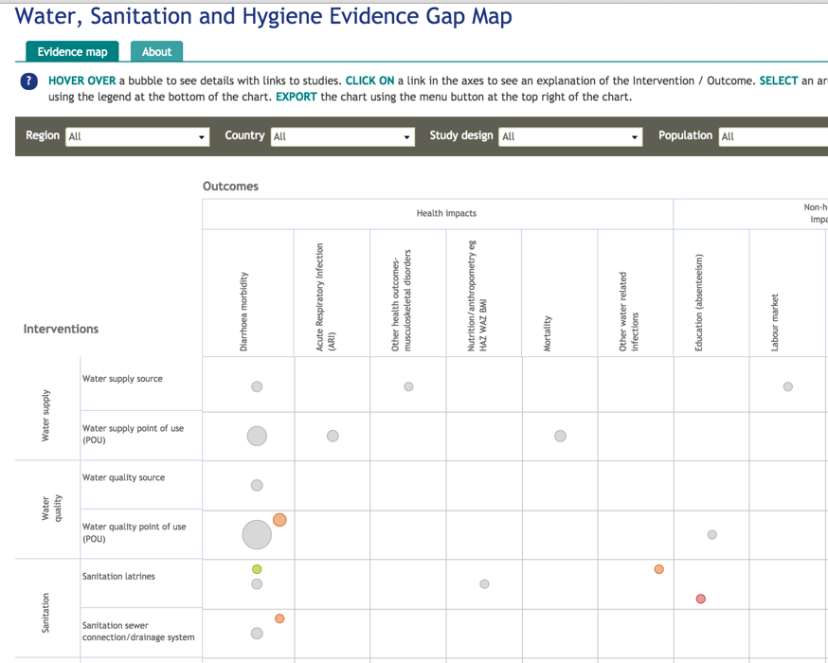
Notes:
For example, this is an evidence gap made generated by the International Initiative for Impact Evaluation that maps out where information exists documenting some impact of an action on specific categories of outcomes in the context of water, sanitation and hygiene projects

Slide 18
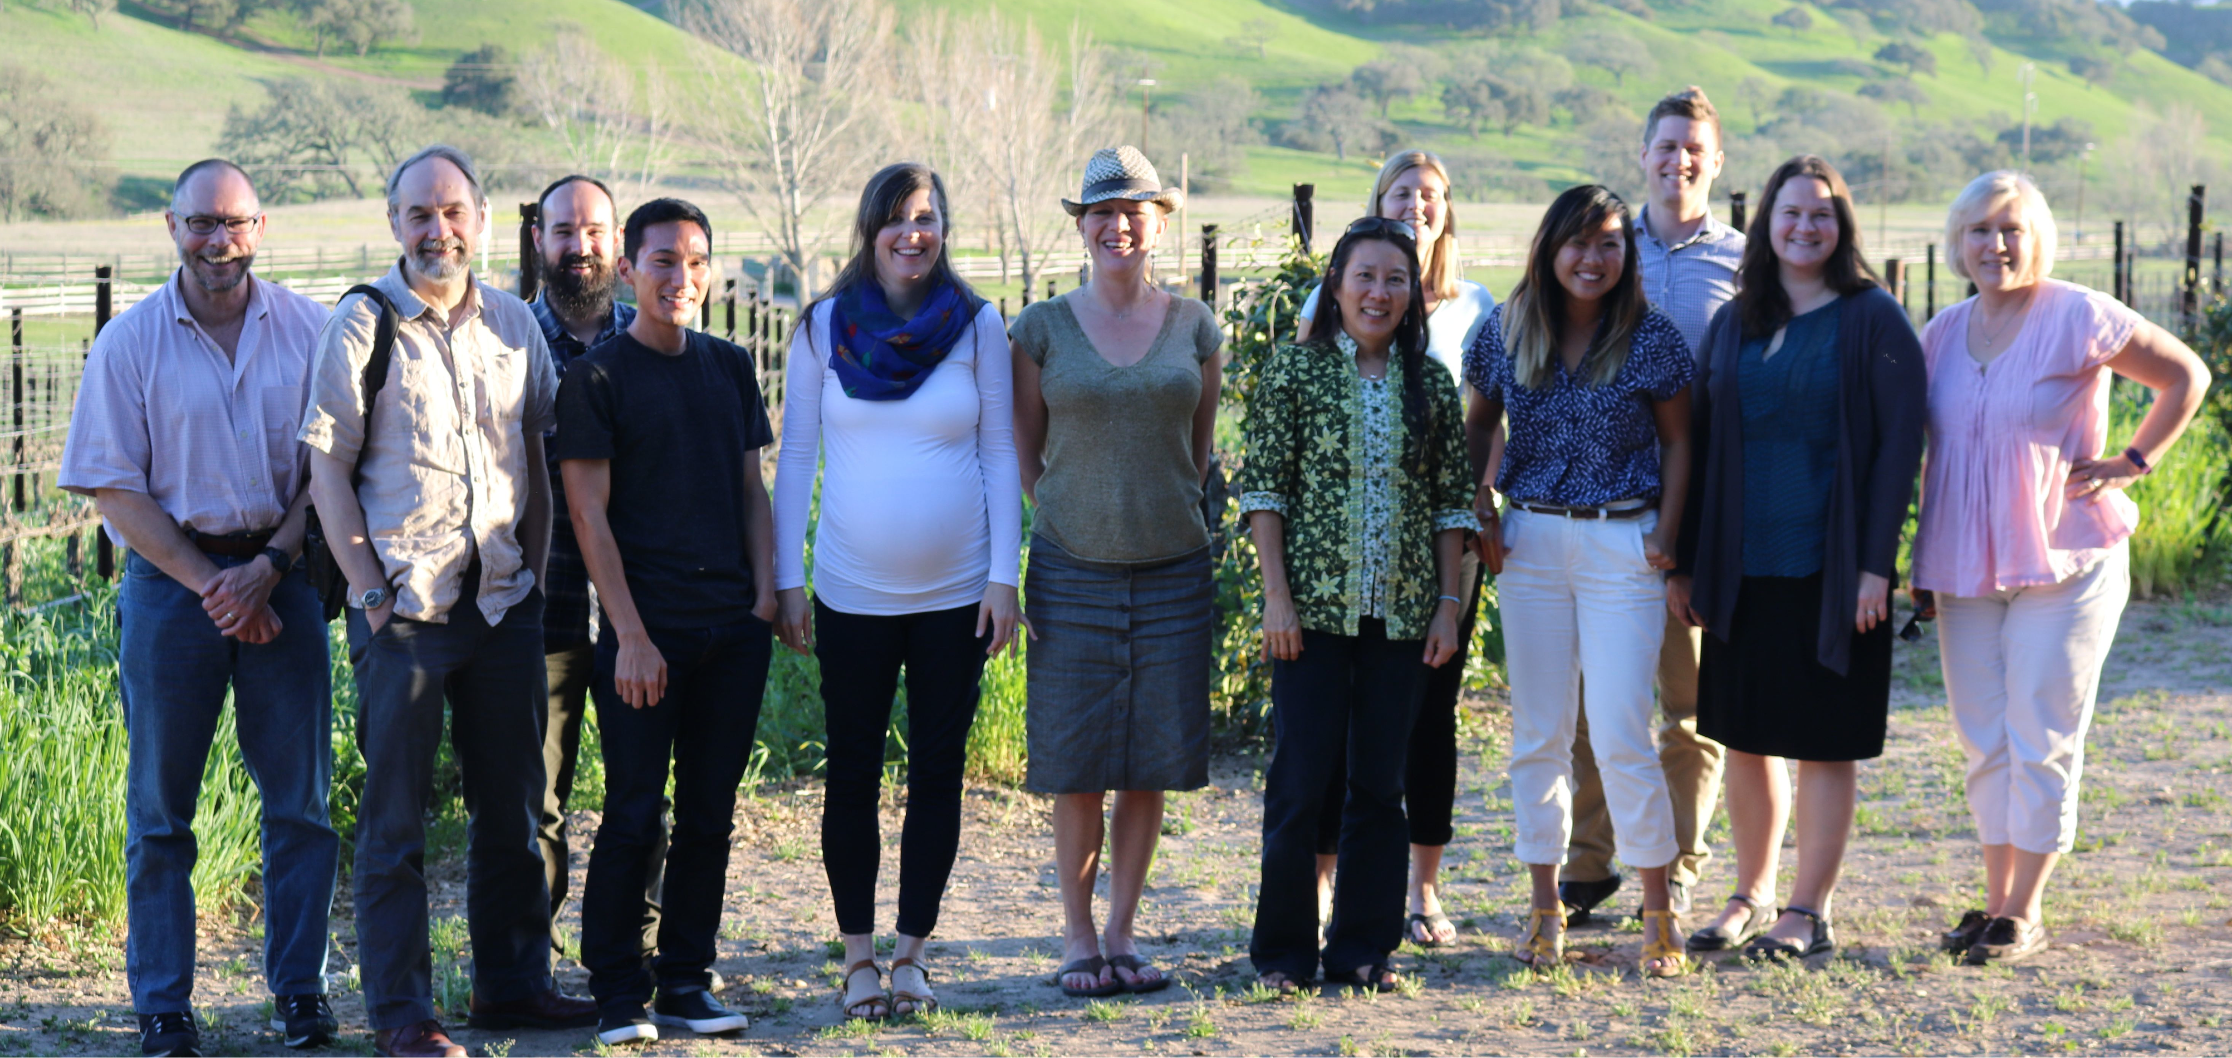
SNAPP Working Group on Evidence-based Conservation
Madeleine McKinnon (lead)
Vulcan
David Wilkie (co-lead)
Wildlife Conservation Society
Samantha Cheng (postdoc)
NCEAS
Louise Glew (WWF-US)
Dilys Roe (IIED)
Ruth Garside (Univ. Exeter)
Supin Wongbusarakum (NOAA)
Maggie Holland (Univ. Maryland)
Andrew Pullin (Univ. Bangor/CEE)
Lynn Dicks (Univ. Cambridge)
Sofia Ahlroth (World Bank)
Valerie Hickey (World Bank)
Birte Snilstveit (3ie)
Daniel Miller (Univ. Illinois)
Yuta Masuda (TNC)
Eliot Levine (Mercy Corps)
Bill Sutherland (Univ. Cambridge)
Emily Woodhouse (UCL/Imperial)
Glenn Althor (Univ. Queensland)
Rebecca Butterfield (USAID)
Chris Cooper (Univ. Exeter)
Kelly Jones (Colo. State)
Peter Darche (DataKind)
Notes:
Improving the process of evidence-based conservation using these systematic tools is the focus of an interdisciplinary Science for Nature and People Partnership working group of which I am a part. This group is lead by Madeleine McKinnon formerly from Conservation International and now at Vulcan and David Wilkie from the Wildlife Conservation Society and involves partners from numerous conservation and development organizations and research institutions.

Slide 19
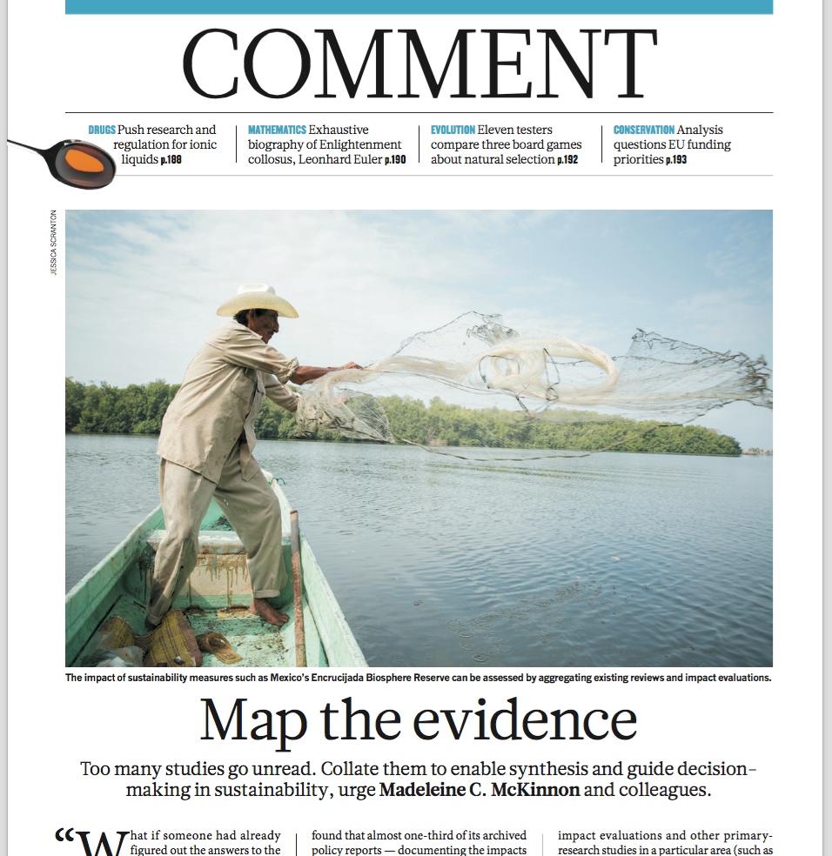
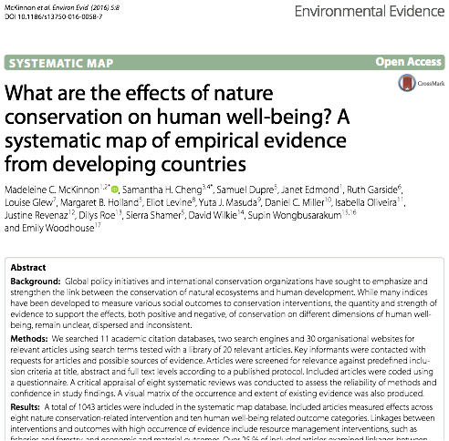
EVIDENCE MAP:
CONSERVATION’S IMPACT ON HUMAN WELL-BEING
Published in Nature
Dec 10th 2015 issue
Bottrill et al. 2014, McKinnon et al. 2015, 2016
Notes:
We are focusing on using evidence-synthesis methods to map where evidence on nature-people linkages exists in order to create a sort of “treasure map and guide” for practitioners to find relevant information and to develop practical tools to facilitate more efficient synthesis and greater access to information

Slide 20
DIFFERENT PATHWAYS FROM INTERVENTIONS TO OUTCOMES
Nature conservation intervention
Biophysical outcome
Human
well-being
outcome
Ecosystem service
Threat reduction
Human
well-being
outcome
Biophysical outcome
Direct and indirect pathways (Bottrill et al. 2014)
Notes:
Currently, there are multiple diverse hypotheses about the explicit impacts of conservation, ranging from direct to indirect pathways and from tangible, measurable outcomes such as income and biomass to intangible outcomes, such as sense of well-being and empowerment. Needing understand which pathways had been studied motivated the creation of this systematic map.

Slide 21
SCOPE OF EVIDENCE MAP
Research Question:
What is the impact of nature conservation on human well-being in developing countries?
Bottrill et al. 2014, McKinnon et al. 2016 - Environmental Evidence
McKinnon et al. 2015, Nature
Notes:
Our primary research question was “what is the impact of nature conservation on human well-being?” We undertook a broad scope for several reasons - it allows us to capture the scale at which strategies, priorities and policies are set as well allowed us to minimize bias by allowing us to capture a comprehensive set of interventions and outcomes as well as articulate multiple pathways at different scales. As well - it allows us to place more specific reviews, for example the impact of protected areas on human well-being - in a broader context

Slide 22
EVIDENCE MAP ON CONSERVATION & HUMAN WELL-BEING
Locate, characterize and assess empirical studies
Identify type and frequency of interventions and outcomes
Assess quality of evidence base
Bottrill et al. 2014, McKinnon et al. 2016 - Environmental Evidence
McKinnon et al. 2015, Nature
Notes:
The goal of the map was to locate, characterize and assess empirical studies on this question and identify the type and frequency of the intereventins and outcomes being examined and assess the overall quality of the evidence.

Slide 23
INCLUSION/EXCLUSION: “PICO” APPROACH
Scope literature
Population
Non-OECD countries
Discrete population
Studies where population is undefined, e.g. global public good
Intervention
Nature-based conservation interventions
Typology based upon IUCN-CMP Conservation Actions framework
Key elements: protection, management, education & awareness, law & policy, markets & incentives, and sustainable use
Environmental management and mitigation (air pollution, waste etc)
Set inclusion criteria
Draft protocol
Conduct search strategy
Screen & assess results
Extract relevant data
Analyse trends/impacts
Bottrill, M.C., et al, 2014. What are the impacts of nature conservation interventions on human well-being: A systematic map protocol. Environmental Evidence 3, 16.
Bottrill et al. 2014, Environmental Evidence
McKinnon et al. 2015, Nature
Notes:
To illustrate the evidence base for this question - we had several inclusion critiera. We included articles that documented some sort of impact on human populations stemming from a conservation action. As this map was originally funded and conceptualized for Conservation International, thus we focused of their primary target regions which consist mostly of non-OECD countries. We included all types of nature-based conservation interventions based on the IUCN-Conservation Measures Partnerships typology.

Slide 24
INCLUSION/EXCLUSION: “PICO” APPROACH
Scope literature
Outcome
Multidimensional aspects of human well-being
Typology based upon combination of MEA; MDGs; Smith et al. 2012 and search terms used by relevant reviews in CEE library
Key dimensions include: poverty, basic materials, security, physical health, mental state, social relations, education, and rights
Studies
Evaluations (quasi and experimental designs)
Case studies
Theoretical studies or models. Reviews and opinions
Set inclusion criteria
Draft protocol
Conduct search strategy
Screen & assess results
Extract relevant data
Analyse trends/impacts
Bottrill, M.C., et al, 2014. What are the impacts of nature conservation interventions on human well-being: A systematic map protocol. Environmental Evidence 3, 16.
Bottrill et al. 2014, Environmental Evidence
McKinnon et al. 2015, Nature
Notes:
We took a multi-dimensional view of human well-being synthesizing a number of commonly used typologies to garner a holistic viewport. Thus we included studies that examined the impact of these conservation actions on both tangible and intangible measures of human well-being with some key dimensions being poverty, health, security and rights. In order to fully capture the type of research that exists and the distribution of quality – we accepted all study designs except for those without empirical data such as modeling studies, general reviews and opinion pieces.

Slide 25
MAPPING PROCESS
Scope literature
Set inclusion criteria
Draft protocol
Online publication databases
Bibliographic searches
Specialist websites
Key informants
Conduct search strategy
Screen & assess results
Extract relevant data
Analyse trends/impacts
Bottrill, M.C., et al, 2014. What are the impacts of nature conservation interventions on human well-being: A systematic map protocol. Environmental Evidence 3, 16.
Bottrill et al. 2014, Environmental Evidence
McKinnon et al. 2015, Nature
Notes:
We conducted our search in online publication databases Web of Science and Scopus, in bibliographies of relevant reviews, through specialist websites for grey literature and through key informants.

Slide 26
BOOLEAN SEARCHING
Scope literature
Set inclusion criteria
("conserv*" OR "protect*" OR "manag*" OR "awareness" OR "law*" OR "policy*" OR "reserve*" OR "govern*" OR "regulation" OR "communicat*" OR "train*” OR “payment for ecosystem services” OR “PES”)
AND
("human well*" OR "poverty” OR “nutrition” OR “skill*” OR “income” OR “clean water” OR “livelihood” OR “food security” OR “resilienc*” OR “capital” OR “shelter” OR “ecosystem service*” OR “attitude*” OR “perception*” OR “human health”)
Draft protocol
Conduct search strategy
Screen & assess results
Extract relevant data
Analyse trends/impacts
Bottrill et al. 2014, Environmental Evidence
McKinnon et al. 2015, Nature
Notes:
We used Boolean searching of different sets of terms and wildcards to try and distill likely relevant studies.

Slide 27
BOOLEAN SEARCHING
Scope literature
Set inclusion criteria
Draft protocol
Adding in qualifying terms (e.g. “marine” OR “forest”)
+
Filtering by source type & subject area
Conduct search strategy
Screen & assess results
Extract relevant data
~35,000 hits
Analyse trends/impacts
Bottrill et al. 2014, Environmental Evidence
McKinnon et al. 2015, Nature
Notes:
And after adding in some qualifying terms and restricting by source type and subject area, o
ur search turned up quite a large number of studies through online databases - around 35,000 potentially relevant hits.

Slide 28
EVIDENCE MAP
35,000 potentially relevant hits
from peer-reviewed articles & grey literature
Screening titles and abstracts
~3,000 relevant articles
Reading full-text, extracting meta-data
1,042 included articles
Bottrill et al. 2014, McKinnon et al. 2015, 2016
McKinnon et al. 2016 - Environmental Evidence
McKinnon et al. 2015, Nature
Notes:
We filtered these down by scanning titles and abstracts for relevancy based on our inclusion criteria and ended up excluding the majority of articles resulting in 3,000 potentially relevant articles for full-text screening. After reading these articles, we ended up with just over 1000 studies included in the final map

Slide 29
THE EVIDENCE BASE

Slide 30
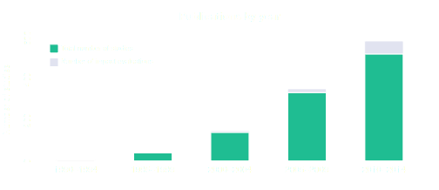
GROWTH IN EVIDENCE BASE:
McKinnon et al. 2016 - Environmental Evidence
McKinnon et al. 2015, Nature
Notes:
We searched for articles from 1970 onwards, finding that the majority of the evidence was published within the last 10 years, indicating an upwards trend in evidence generation in this topic.

Slide 31
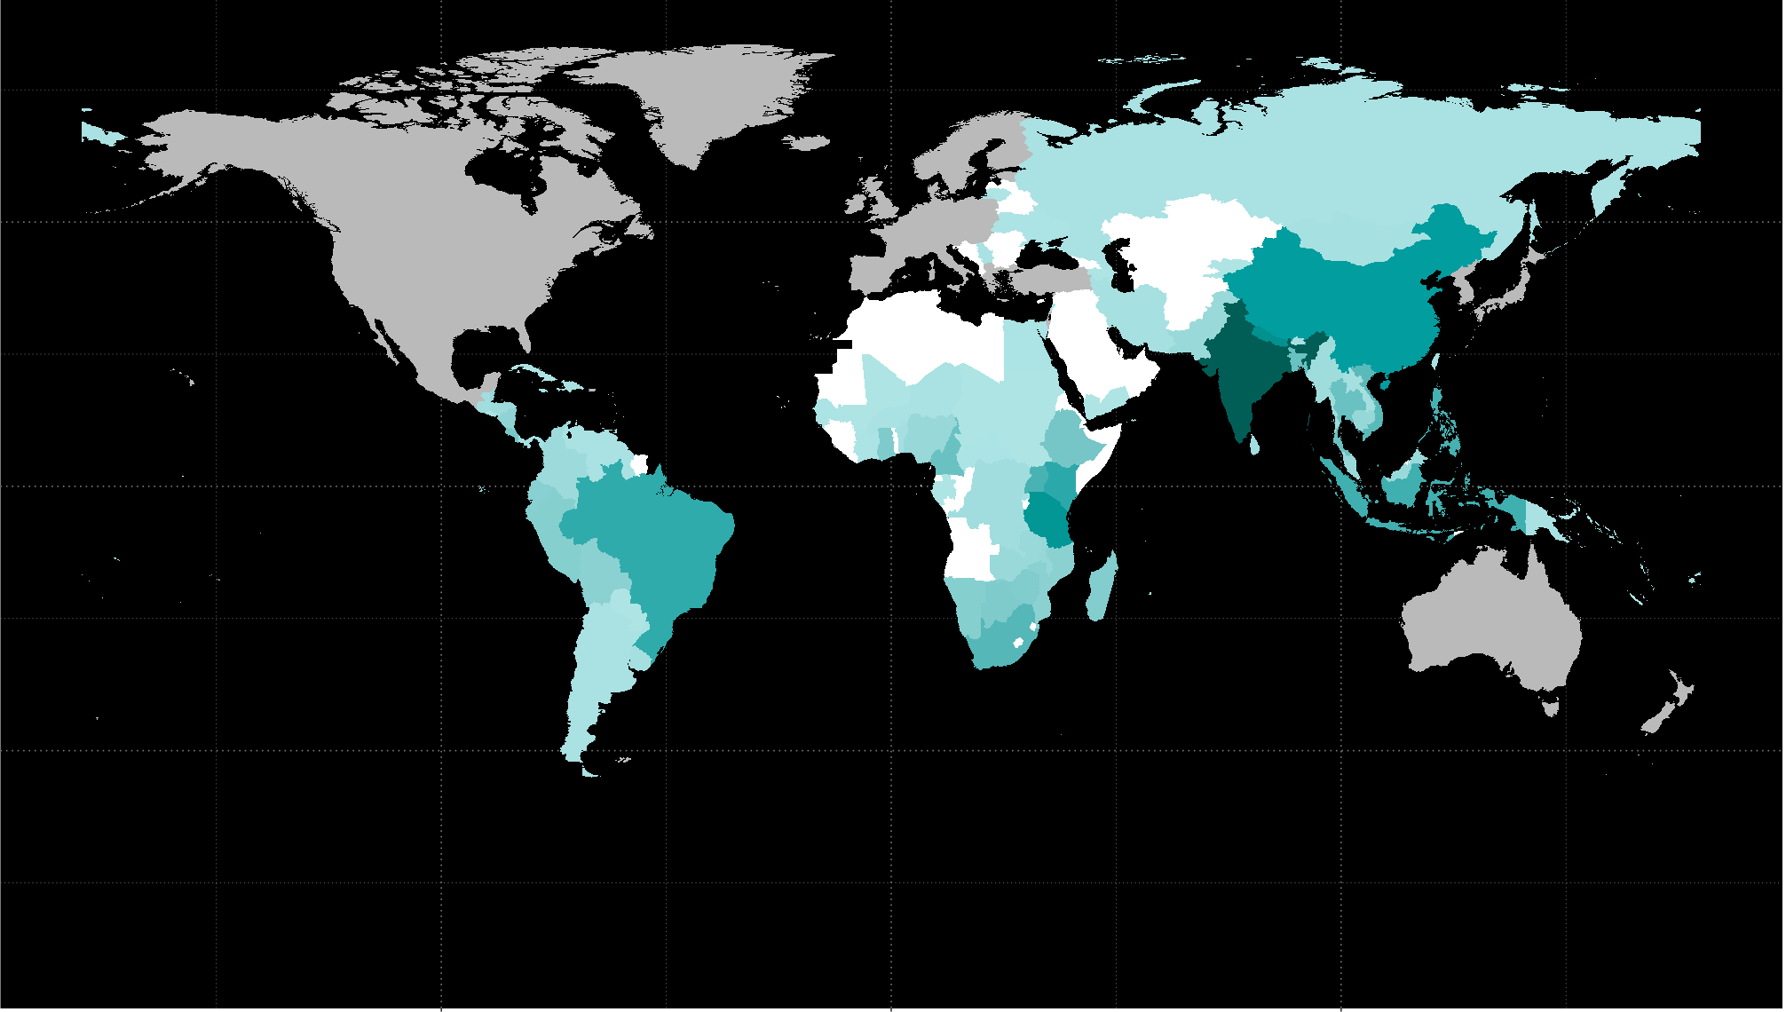
GEOGRAPHIC TRENDS:
Frequency and distribution of study location
Number of
articles
120
90
60
30
0
OECD
McKinnon et al. 2016 - Environmental Evidence
McKinnon et al. 2015, Nature
Notes:
The resulting evidence base indicates different trends in the frequency and distribution of data. Geographically, we observed a heavy concentration of studies in India, Nepal and Brazil and an overall heavy bias in studies in Asia but barely any studies in the Middle East and West Africa. To address these biases, we are conducted searches of literature in other languages besides English - including French, Spanish and Portguese. However, this has yielded few studies. For example, the search for Portuguese studies identified just 24 relevant studies.

Slide 32
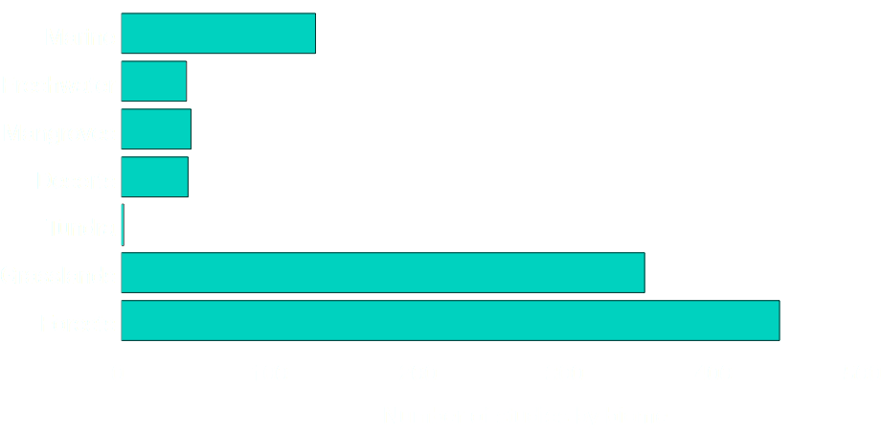
GEOGRAPHIC TRENDS:
Frequency and distribution of studies by biome
McKinnon et al. 2016 - Environmental Evidence
McKinnon et al. 2015, Nature
Notes:
A significant proportion of studies focused on forests – both in temperate and tropical ecosystems
Marine studies were also substantial.
Less well-studied ecosystems include deserts, wetlands & mangroves and estuaries

Slide 33
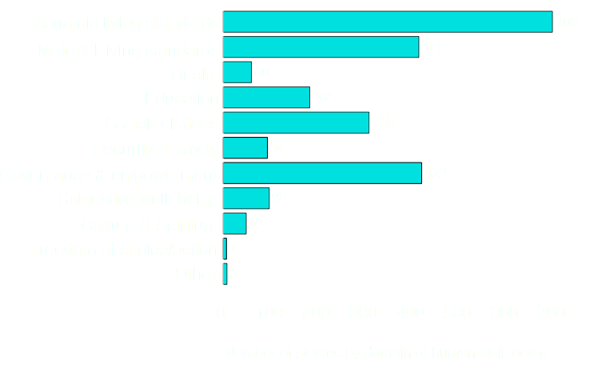
EMPHASIS ON ECONOMIC WELL-BEING
McKinnon et al. 2016 - Environmental Evidence
McKinnon et al. 2015, Nature
Notes:
The evidence base shows a variability in how evidence is distributed.
For example…

Slide 34
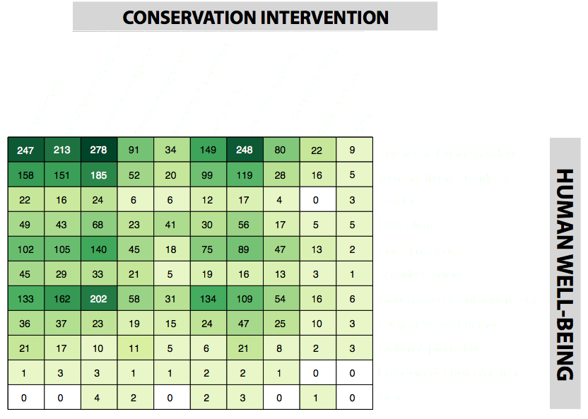
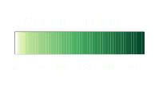
QUANTITY OF EVIDENCE BASE:
Frequency and distribution of linkages
McKinnon et al. 2016 - Environmental Evidence
McKinnon et al. 2015, Nature
Notes:
We present the intersection of specific conservation interventions and human well-being outcomes as a visual heatmap of linkages. This allows us to visualize the distribution of evidence and observe where the potential knowledge gluts and gaps are.

Slide 35
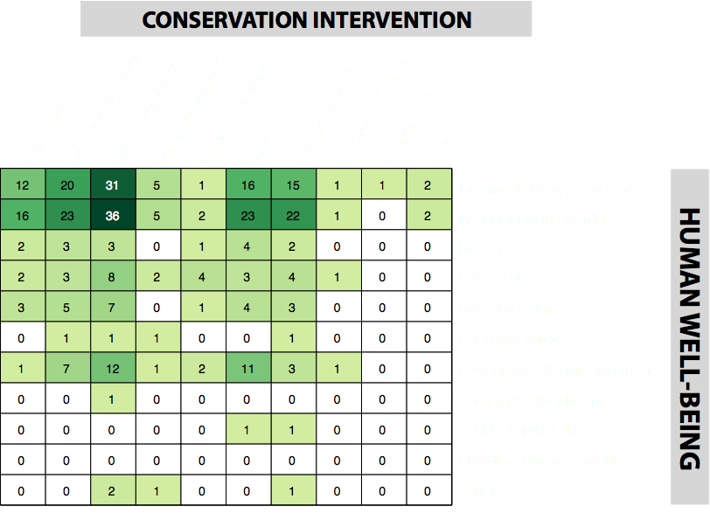
ROBUSTNESS OF EVIDENCE BASE:
Frequency and distribution of impact evaluations
McKinnon et al. 2016 - Environmental Evidence
McKinnon et al. 2015, Nature
Notes:
We can further disaggregate the evidence base and filter it by study robustness. Not all studies are created equally - we found that relatively few studies were in fact impact evalutions - that is a study including a counterfactual in order to attribute an observed outcome to a hypothesized cause. These counterfactuals include comparisons before and after implementation, or between sites with and without the intervention, both with and with a control. The lack of robustness of study designs, or lack thereof, is one of the most prominent biases observed in the evidence base. Which has also been observed in other related reviews on biodiversity and poverty and on protected areas and human well-being.

Slide 36
KNOWLEDGE GLUTS
Impact of conservation actions on economic living standards
Governance and empowerment outcomes
McKinnon et al. 2016 - Environmental Evidence
McKinnon et al. 2015, Nature
Notes:
Specifically examining the map, we can see where some so-called knowledge gluts are. There is a substantial amount of evidence documenting impacts of on primarily economic living standards and governance. On one hand, the high occurrence of evidence on these linkages confirms the continued predominance of economic constructs of poverty and development. On another, upon closer examination, these outcomes also have more rigorous impact evaluations and systematic reviews than other human well-being outcomes, thus, on the other hand, these areas present ripe opportunity to carry out additional synthesis on these linkages and conduct in depth examinations in specific regions or biomes.
Synthesis of this evidence across intervention types opens up new possibilities for assessing the relative effectiveness of different and some emerging strategies, such as market-based approaches, in realizing economic/material well-being goals, but also possible trade-offs with other aspects of well-being. Despite its value to theory, policy, and practice, there has been little to no comparative research of this kind to date.
The second area ripe for more detailed synthesis concerns governance and empowerment outcomes, especially in relation to area and resource management. As effective governance of natural resources is both desired outcome, but also a factor affecting the achievement of other social and ecological outcome, this is a particularly pressing area for synthesis to help inform conservation programs that aim to target gaps or weaknesses in governance in their activities.

Slide 37
KNOWLEDGE GLUTS
Impact of nature conservation on human health
Subjective measures of well-being - e.g. culture, spiritualitys
McKinnon et al. 2016 - Environmental Evidence
McKinnon et al. 2015, Nature
Notes:
Conversely, the map allows us to identify areas where there are very few studies. Limited or non-existent evidence, or gaps, on a specific linkage might be due to either a systemic bias in research efforts or rather to a lack of theory supporting a causal relationship between a specific intervention and outcome. Or for more subjective outcomes, such as those associated with culture, outcomes may not be observable for long time scales and is more difficult to consistently collect, especially over broad scales.
Surprisingly human health had relatively few studies given the propensity of assumptions that healthy environments lead to healthy people through provisioning of water and food.

Slide 38
KNOWLEDGE GLUTS
Impact of nature conservation on human health
Information on conservation of freshwater ecosystems
McKinnon et al. 2016 - Environmental Evidence
McKinnon et al. 2015, Nature
Notes:
Biases in research efforts have significant effect of the extent and distribution of existing evidence. For example, we see a disproportionate percentage of the evidence base focused on forest, but comparatively, much less on other biomes, including freshwater systems.

Slide 39
HOW THIS CAN BE USED: 3 recommendations based on level of study occurrence
HIGH: invest in systematic reviews to assess interventions and impacts
MODERATE: invest in impact evaluations to increase and/or improve evidence
LOW: invest in theory development to explore or validate current thinking
McKinnon et al. 2016 - Environmental Evidence
McKinnon et al. 2015, Nature
Notes:
We suggest that this evidence map can be used in three different ways. The areas with high amounts of evidence - the so called knowledge gluts - we would recommend are ripe for a systematic review in order assess the interventions and delineate specific pathways to impact. In areas where amount of evidence is only moderate - we recommend more investment in conducting impact evaluations in order to increase and/or improve the evidence. Lastly, in areas where there is little or no evidence - this indicates that we need to invest in theory development in order to explore or validate our current thinking in why a link between these particular interventions and outcomes exists or simply, do more research

Slide 40
SUMMARY OF FINDINGS
Evidence base growing, but considerable biases persist
Further synthesis possibles on linkages with conservation & governance; resource management + economic/material outcomes
Significant gaps in impacts of conservation on health, cultural values
Major investment in improved study design required
McKinnon et al. 2016 - Environmental Evidence
McKinnon et al. 2015, Nature
Notes:
Overall, we found that the evidence base for nature-people linkages is growing, but there are considerable geographic, biome and study biases - with more intangible outcomes relatively little studied and very surprisingly - health. However, there are some areas that are ready for further synthesis on the linkages. Overall - we find that the robustness of studies and thereby, the reliability of these studies attribute effects to conservation measures - is low. In order to improve our understanding of how conserving nature can benefit people - we need increase awareness of and investment in improving study designs.

Slide 41
WHAT DO I DO WITH A MAP?
Notes:
What do I do with a map?

Slide 42
DIVING INTO THE EVIDENCE MAP
What information exists on food security outcomes?
Food availability
Food utilization
Food access
Notes:
For example, if we are interested to find information about food security outcomes and their links to nature-based conservation actions, we can query the map. First, to find information, we need to determine what specific type of outcome we are looking for and where it fits into this map. Food security is defined with three main components, availability, access and utilization – which very broadly, nest within the categories of material living standards, security and safety and health.

Slide 43
DIVING INTO THE EVIDENCE MAP
What information exists on food security outcomes?
Food availability
Food utilization
Food access
Notes:
For this example, we will focus on food availability.

Slide 44
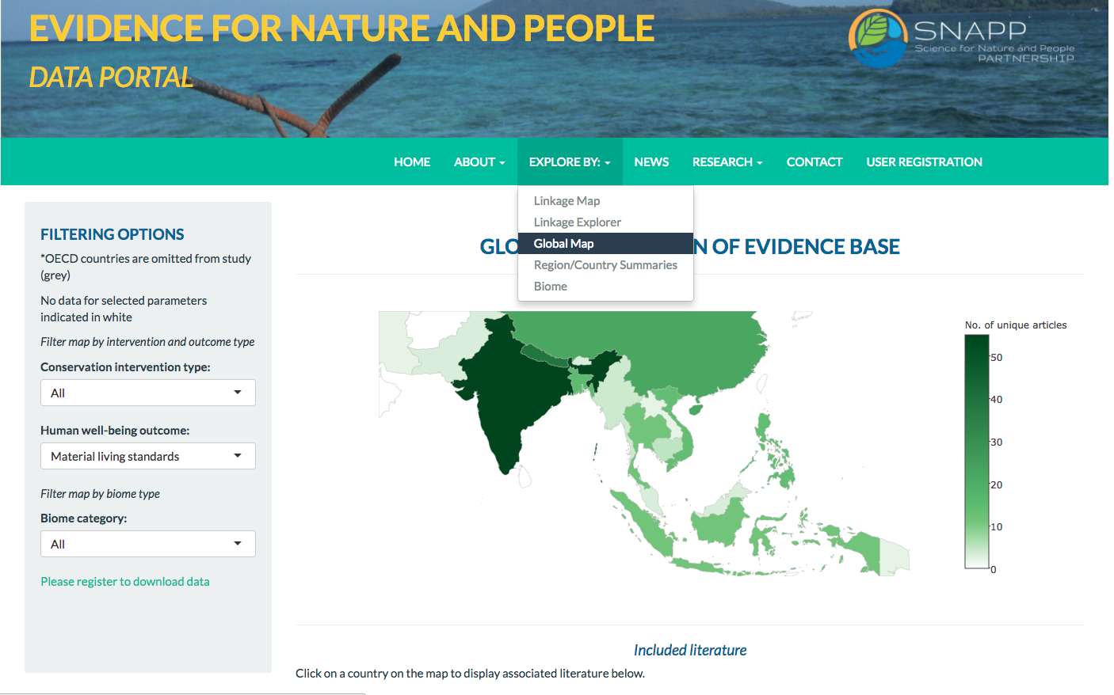
DIVING INTO THE EVIDENCE MAP
What information exists on food security outcomes?
Find, explore, & download data with online data portal
www.natureandpeopleevidence.org
Notes:
To do this, we have created an online, open access data portal where you can filter and explore data from this map using an interactive interface and data visualization widgets.

Slide 45
DIVING INTO THE EVIDENCE MAP
What information exists on food security outcomes?
424
ARTICLES
on material
living standards
www.natureandpeopleevidence.org
Notes:
We would then first filter the database by articles on material living standards finding 424 articles that cover the topic. As this map was conducted at a very high level – this is the limit of disaggregation in terms of outcome types.

Slide 46
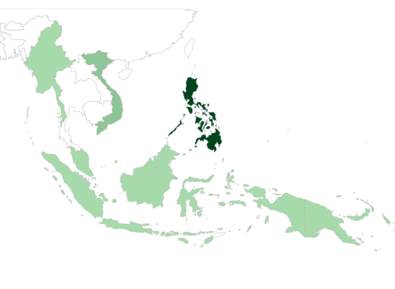
DIVING INTO THE EVIDENCE MAP
Filtering for geography and biome
424
31
6
ARTICLES
on material
living standards
ARTICLES
in marine
ecosystems
ARTICLES
in Southeast Asia
www.natureandpeopleevidence.org
Notes:
However, you can further distill the information by other criteria such as geography and biome, for example, if I were specifically interested in finding research pertaining to food security in marine ecosystems of Southeast Asia – I could drill down to those 6 studies that contain information that I might want. I can also visualize the distribution of articles over the region.

Slide 47
DIVING INTO THE EVIDENCE MAP
Filtering for geography and biome
424
31
6
ARTICLES
on material
living standards
ARTICLES
in marine
ecosystems
ARTICLES
in Southeast Asia
FIND
articles covering
impact on
food resources
DOWNLOAD
data
+
bibliography
www.natureandpeopleevidence.org
Notes:
From the site, you can then download the associated data from our map and the curated bibliography and use this to find articles covering some impact on food resources.

Slide 48
USING THE MAP
NEEDS:
What is the evidence for forests as a pathway out of poverty?
Monitoring & Evaluation
Research
EVIDENCE FOR
NATURE AND PEOPLE
DATA PORTAL
Actions
Outcomes
Implementers
Poverty
Shared
prosperity
Find and synthesize evidence
Summarize effective pathways
Communicate via:
FORESTS AND POVERTY
DATA PORTAL
Adjustment of actions
Notes:
This is just one way to explore the evidence contained in the map at a high level. Ultimately, we want to be able to use the evidence in this map to understand what works and what we know. Currently, we are conducting a spin-off study with the Program on Forests at the World Bank to understand the extent to which forests can serve as a pathway to poverty alleviation and shared prosperity. This work is being done in collaboration with NCEAS and University of Illinois.

Slide 49
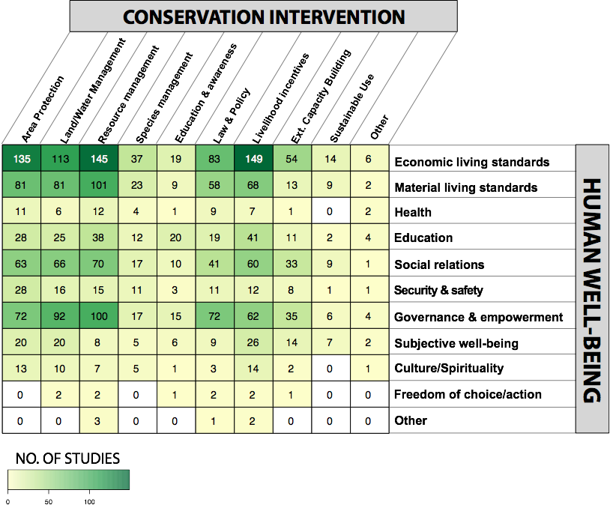
MAP JUMP STARTS SEARCH FOR EVIDENCE
Forest studies from McKinnon et al. 2016 map on conservation & human well-being linkages
564 hits
Notes:
Specifically, we are using the map to jump start the first stage of the program’s strategic plan – knowledge discovery – by aiding the search for evidence and minimize duplicating efforts. Our map documented 564 articles that examined links between conservation and human well-being in forest ecosystems.

Slide 50
ADDITIONAL SEARCHING
Online databases 2014-2016
"REDD+" OR "REDD" OR "FLEGT" OR "forest management" OR "forestry" OR "CBNRM" OR "community-based natural resource manag*" OR "resource manag*" OR "conservation agreement" OR "national park" OR "biosphere reserve" OR "nature reserve" OR "conservation area" OR "extractive reserve" OR "afforest*" OR "reforest*" OR "NTFP*" OR "non-timber forest product" OR "non timber forest product*" OR "silvicultur*" OR "silvi-cultur*" OR "PES" OR "payment for ecosystem services" OR "incentive*" OR "tenure*"
"voluntary" OR "participatory" OR "collective" OR "public" OR "private" OR "commercial" OR "sustainable" OR "illegal" OR "community"
"poverty" OR "income" OR "empower*" OR "job*" OR "livelihood*" OR "security" OR "attitude*" OR "capital" OR "traditional knowledge" OR "TEK" or "*equity"
"forest*" OR "woodland*" OR "agroforest*" OR "silvopast*" OR "coffee" OR "charcoal"
+
+
+
999 hits
Notes:
We branched off these studies by conducting a forest-specific search – looking for specific forest-based programs and additional terms for poverty outcomes to search for additional information from 2014 – the most recent year our map documents – until the present day.

Slide 51
SEARCH RESULTS
Excluded from McKinnon map
n=2,094
Database search: 2014-2016
n=999
Expert opinion, bibliographic searches, grey literature
n= TBD
McKinnon map
n=564
Duplicates removed
n=415
Potentially relevant records to be screened at title and abstract
n=3,657
Notes:
Using information from this map, additional searches and grey literature searches – we have a partially refined pot of information to search within to understand links between forest resources and poverty.

Slide 52
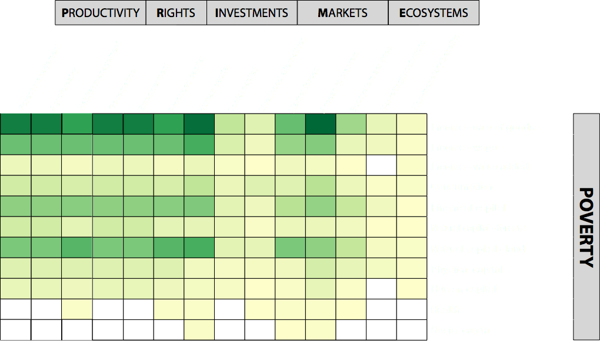
PLANNED OUTPUT
Notes:
Using this approach, our goal is to create a spin-off map specifically on forest production and extraction in line with the frameworks the PROFOR program uses to inform actions.

Slide 53
CONCLUSIONS

Slide 54
BENEFITS OF EVIDENCE MAPPING
“Treasure map” of where to dig for evidence
Highlights knowledge gaps and gluts to define research priorities
Highlights possible intersections and trade-offs between conservation, sustainability and development
Tool to support, design, implement and monitor interventions at all scales
Notes:
By synthesizing existing evidence into a single, searchable resource, the map becomes, in effect, a ‘treasure’ map, simultaneously revealing rich veins of evidence ripe for deeper synthesis as well as under-explored topics for targeted research. The evidence map allows conservation scholars, policymakers and practitioners to mine the evidence base to support a range of decisions.
At first pass, the map provides a ‘potted’ reading list for particular interventions or outcome types, potentially saving considerable time and resources for anyone interested in this topic. Presentation of data from the map in the Evidence for Nature and People Data Portal allows for dynamic and interactive exploration and filtering of the data - increasing the accessibility of previously inaccessible information.
For scholars, the map highlights immediate research priorities such as associations between individual intervention-outcome linkages
For policymakers, the map helps place specific interventions into a broader context by highlighting possible intersections between conservation, sustainability and economic development. Development agencies such as the World Bank or USAID, therefore, might use the map to assess the extent to which conservation might present an alternative strategy to achieving poverty alleviation to compare with existing strategies.
For practitioners, the map offers a tool to support design, implementation and monitoring of conservation interventions at local, national or global scales. The map might also be used to inform and guide monitoring of conservation programs by highlighting relevant indicators and tested methods for tracking them. The map can also inform allocation of monitoring efforts. For example, where evidence is currently lacking and therefore impacts are uncertain, it might be beneficial to direct monitoring to these areas to help manage potential risks.

Slide 55
CAVEATS FOR MAP
High occurrence ≠ Positive impact
Provides single snapshot, but potential to be dynamic
Need for as clear and discrete typologies as possible
Notes:
However, what is important to remember here is this map is in essence a map - it does not tell you what a particular linkage is like once you dive in. High occurrence of evidence does not equate positive outcomes. Or in the words of a co-author – we don’t know if this treasure chest is full of gold or empty rum bottles. Rather, think of it as a road map for exploration – that can save significant time for future researchers to quickly scope the state of current research in the field. While this map provides a single snapshot in time there is potential to make it dynamic. Moreover, in implementing the systematic map process - we identified various issues within the conservation and development sector that need to be improved in order to facilitate rapid uptake of evidence for decision making. Perhaps the most pressing being the need for clear and discrete typologies - in how the sector is categorizing and describing what it is doing and what it is trying to achieve - in a replicable and agreed upon manner so that we can increase the amount of cross-cutting information.

Slide 56
BENEFITS OF EVIDENCE MAPPING
Generation of systematic maps in conservation and development is growing
Haddaway et al. 2016
Notes:
The use of systematic maps in conservation and development is growing rapidly, this is just a quick snap shot of the maps that have been published and protocols for those in progress. Given the great number of challenges we face in achieving sustainable development, knowing where to direct our efforts is absolutely vital to effective conservation. Moreover, if anything, the evidence base indicates that there are a lot of people engaged in conducting research in this area. In order to maximize our efforts and avoid duplication, systematic maps can serve as a rally point to bring together researchers from various fields on a topic and dig in and synthesize comprehensive information on how we achieve a more sustainable planet.

Slide 57
QUESTIONS?
Contact:
Samantha H. Cheng
cheng@nceas.ucsb.edu
@pilesofsquid
www.natureandpeopleevidence.org
Funding support
Gordon & Betty Moore Foundation
Science for Nature and People (SNAP) Partnership

