Slide 1
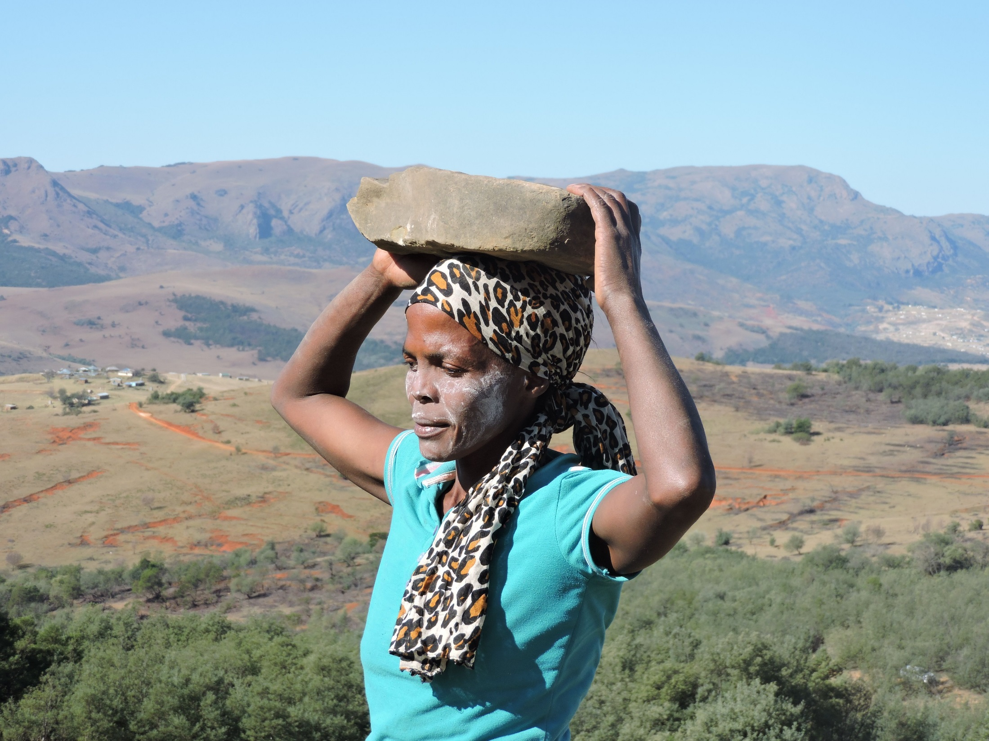
One Health in the mzimvubu catchment,
South Africa
Colleen Sorto
Senior Manager, Peace and Development Partnerships
THE POLICY CENTER FOR ENVIRONMENT AND PEACE
Notes:
One Health initiative integrates WASH activities with livestock improvement and conservation programs.

Slide 2
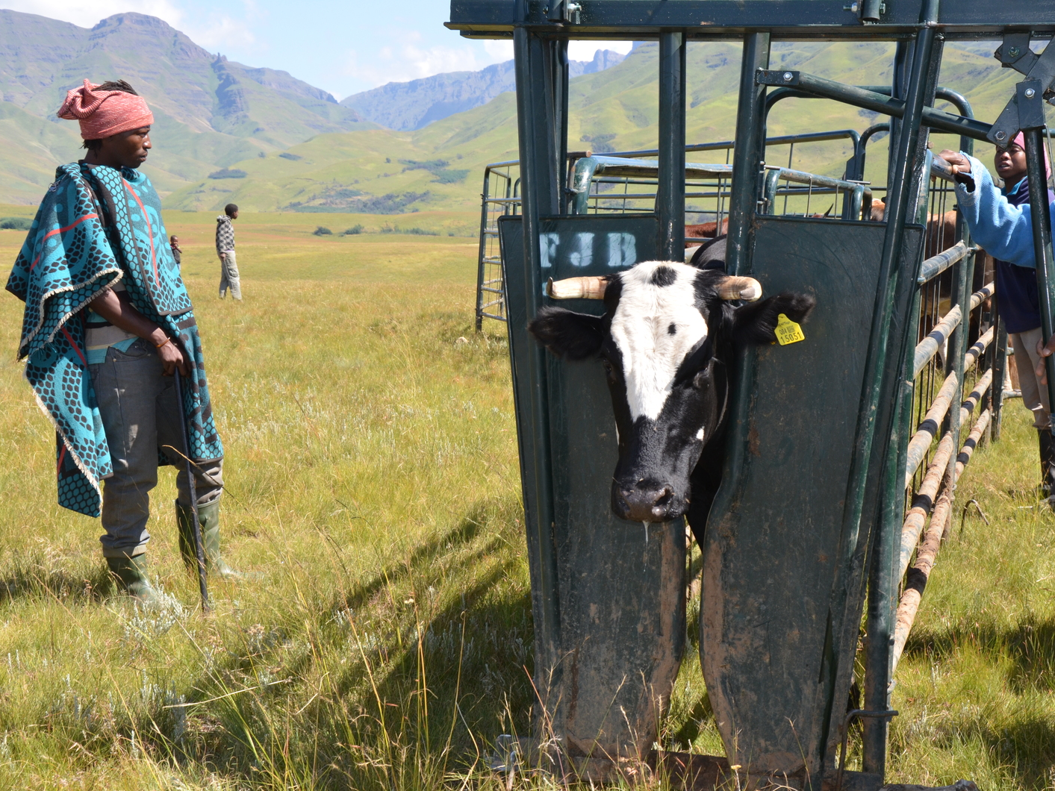
Why “One Health?”
Mzimvubu catchment spans over two million hectares of the poorest rural areas of South Africa’s Eastern Cape Province. This critical ecosystem provides water to approximately one million people and supports more than 2,000 plant and animal species that are unique to this area.
The catchment is presently under threat due to the degradation of land from overgrazing, the loss of land to water-thirsty invasive vegetation, and vulnerability to the impacts of climate change.
Rural communities also face significant challenges: unemployment is higher than the national average, with many people dependent upon social grants and the landscape for their livelihoods. The proportion of households with access to piped water inside the home or yard is as low as 16 percent, and waterborne diseases pose a risk to youth and the elderly.
Notes:
Clearing leads to a release of water, but over time, without management by cattle, the alien trees just grow back and/or the top soil erodes to the point where nothing can grow. Thus, the livestock-based livelihood is the solution for the landscape rehabilitation, which in turn sustains water for other livelihoods and all of this is underpinned by health—healthy village herds; healthy landscapes; and healthy communities.
We believe by empowering local communities to manage and benefit from their natural resources, and supporting local governance structures that enable sustainable livelihoods, “One Health” can secure water futures for all water users.

Slide 3
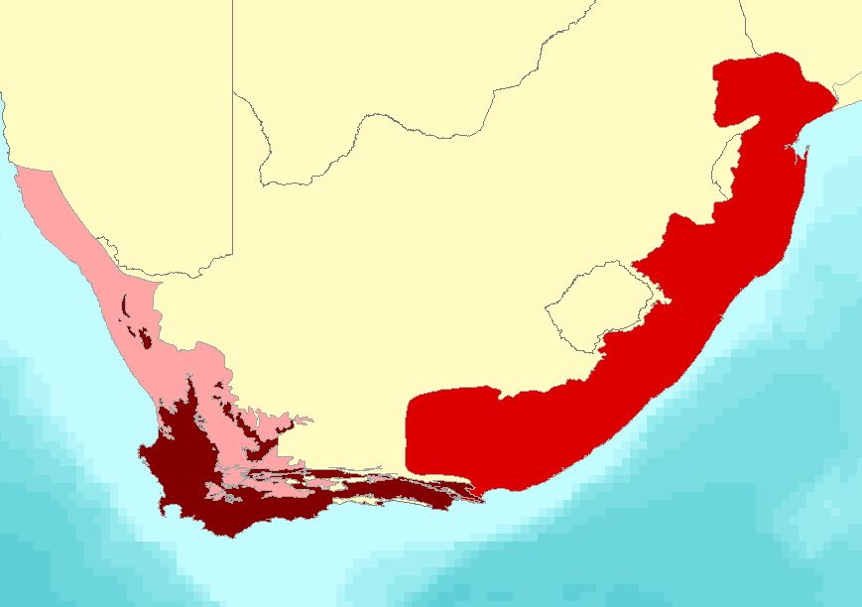
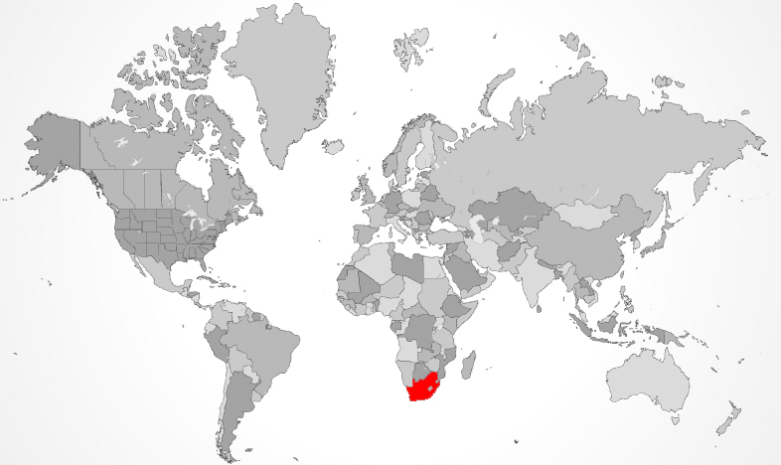
Maputaland-Pondoland
Project sites in the
Upper Catchment
Succulent
Karoo
Cape
Floral
Kingdom
Mzimvubu
Watershed
Notes:
The project area is circled in yellow. It is at the foot of the Drakensburg mountains, next to the border of Lesotho.

Slide 4
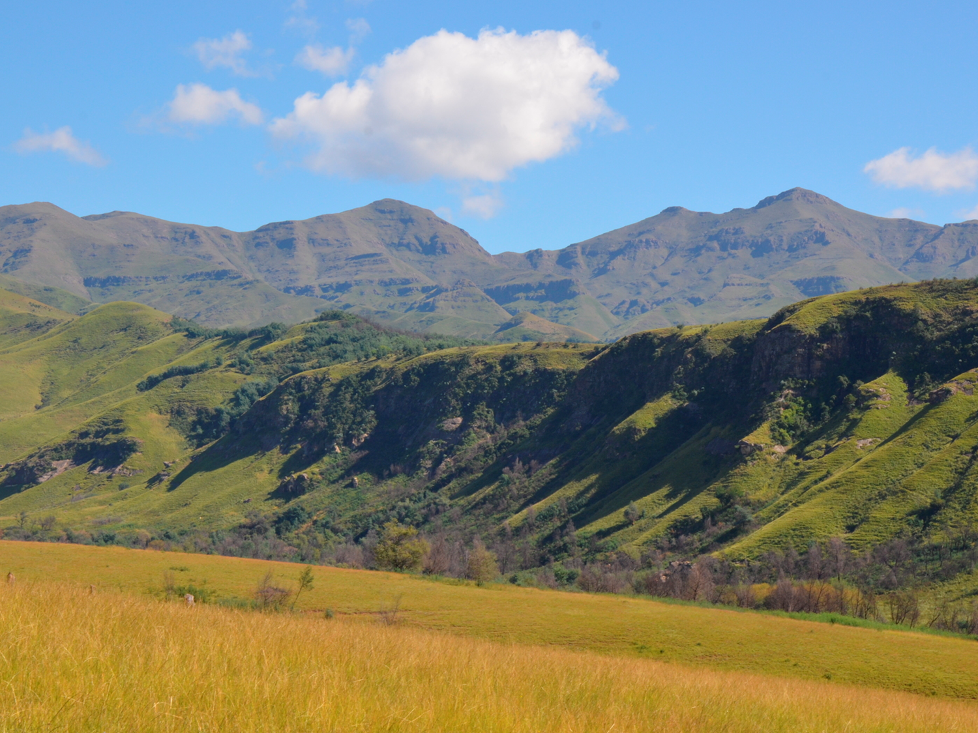
Application of ABCG I Tools
Notes:
This project draws on work from the Africa Biodiversity Collaborative Group—a consortium of seven international conservation NGOs—to develop project implementation guidelines and a monitoring and evaluation (M&E) framework and indicators to measure the added value of integrated freshwater conservation and WASH programming.
Our WASH partner: The Alfred Nzo District Municipality (ANDM), covers approximately 70 percent of the watershed. They recognize the importance of fresh water for the region’s poverty alleviation efforts and continued economic growth. ANDM is partnering with CSA to share WASH data, complementary tools, and raise awareness among all stakeholders about the intersection of socio-economic and environmental issues in the catchment. CSA’s relationship with ANDM helps to support how policy decisions are implemented at a local level and provide a feedback loop from the local level back to decision makers. The existing disconnect largely contributes to why land management practices, WASH investments, and climate change adaptation strategies decisions are happening in silos.

Slide 5
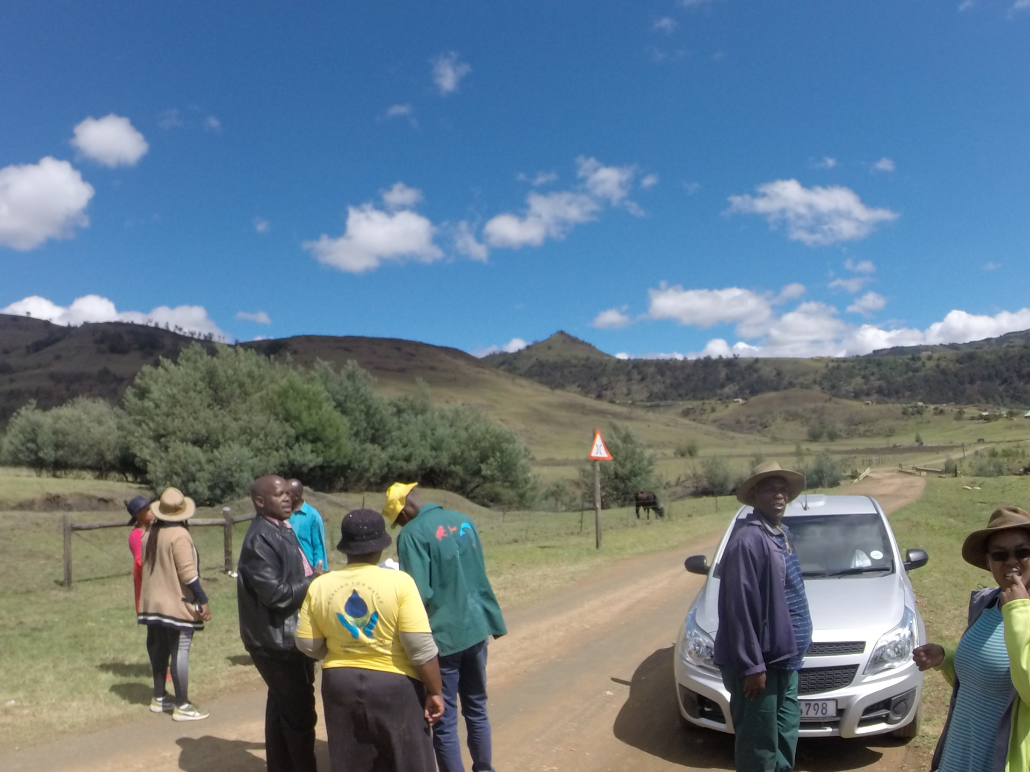
Year 1 highlights
Baseline analysis was completed – including water quality and quantity measurements, info about sanitation and hygiene practices and forestry/land management practices
Completion of a gender analysis and application of findings to program plans and monitoring
8 water monitors volunteers have been trained and are collecting data at both ANDM taps and natural springs
8 natural springs restored and water source protected
Notes:
The One Health project has designed a “living” Performance Monitoring Plan (PMP) to plan and manage the collection of data in order to track progress. It contains full documentation of the indicators with a clear definition of each, rationale for its inclusion, and a description of the methodology for collecting data. It also describes how the indicators will be disaggregated by geographic locations (villages), sex and age group.
CSA held four community meetings to socialize and engage individuals in the One Health Project, in coordination with the leaders of the traditional courts, worked with community volunteers to map (via GPS coordinates) the natural springs where community members are sourcing their water, researched best practices for rehabilitation of degraded springs and conducted one hygiene awareness activity, in coordination with ANDM
8 springs may not sound like a lot – but this was very physical labor that involved clearing rocks and debris by hand – mostly completed by volunteers and 2 CSA staff members. As much as possible, we tried to procure “natural” materials and if things had to be purchased, we make sure they were available locally

Slide 6
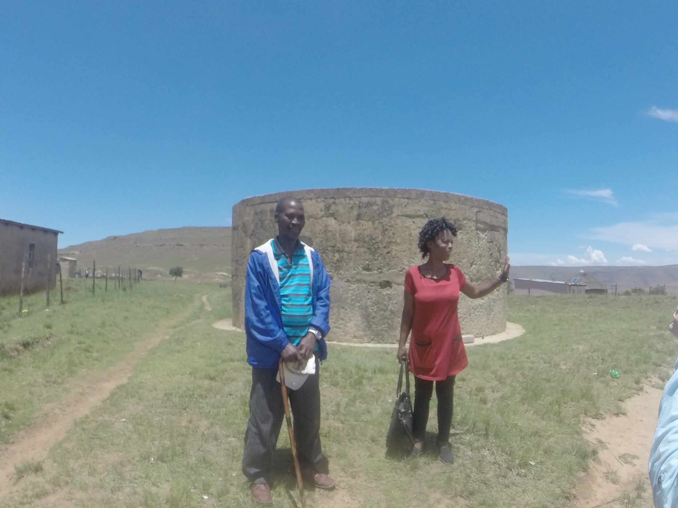
One health in action
In the words of CSA staff ….
Notes:
The “One Health” initiative integrates WASH activities with livestock improvement and conservation programs to improve the health of people, animals and ecosystems. Conservation South Africa (CSA) is applying this framework in the upper reaches of the Mzimvubu Catchment to improve water resources sustainability and resilience to threats, including climate change. Water points throughout the country are linked to natural sources that are being degraded and have high bacterial counts from polluted upstream sanitation infrastructure, resulting in illness outbreaks downstream. Working with the Alfred Nzo District Municipality (ANDM), and utilizing WASH +Conservation Integration guidelines and monitoring framework, CSA is seeking to restore 435,000 ha of watershed, guide government investments in infrastructure for water access and sanitation, and employ and train local communities in removal of invasive alien plants and environmentally-driven livestock management efforts. Over three years, this broad initiative will directly benefit 130,471 people in 25 communities, and improve water health for over one million additional downstream users
Overall goals: Improved water quality for 130,471 direct and <1-million indirect beneficiaries
Decreased pollution of water resources of the 435,000 hectares in the upper catchment
Improved health of people, close to 500,000 direct and 1-million indirect beneficiaries and livestock
CSA is working with government partners, members of the traditional governance systems of the local communities, and is a partner of the Mzimvubu Catchment Alliance, a 35-member partnership focused on sustainability efforts for the Mzimvubu catchment.

Slide 7
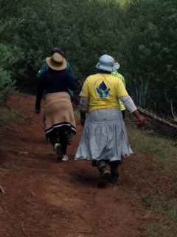
Plans for year 2
Focus shifting to improving sanitation and hygiene practices
Improving health data collection and monitoring
Design and deployment of Training of Trainers for livestock herders
Sharing broader messages with community members
Climate, health and livestock summit
Notes:
Planning a climate, WASH and livestock summit with ANDM representatives to better connect local challenges with policy

Slide 8
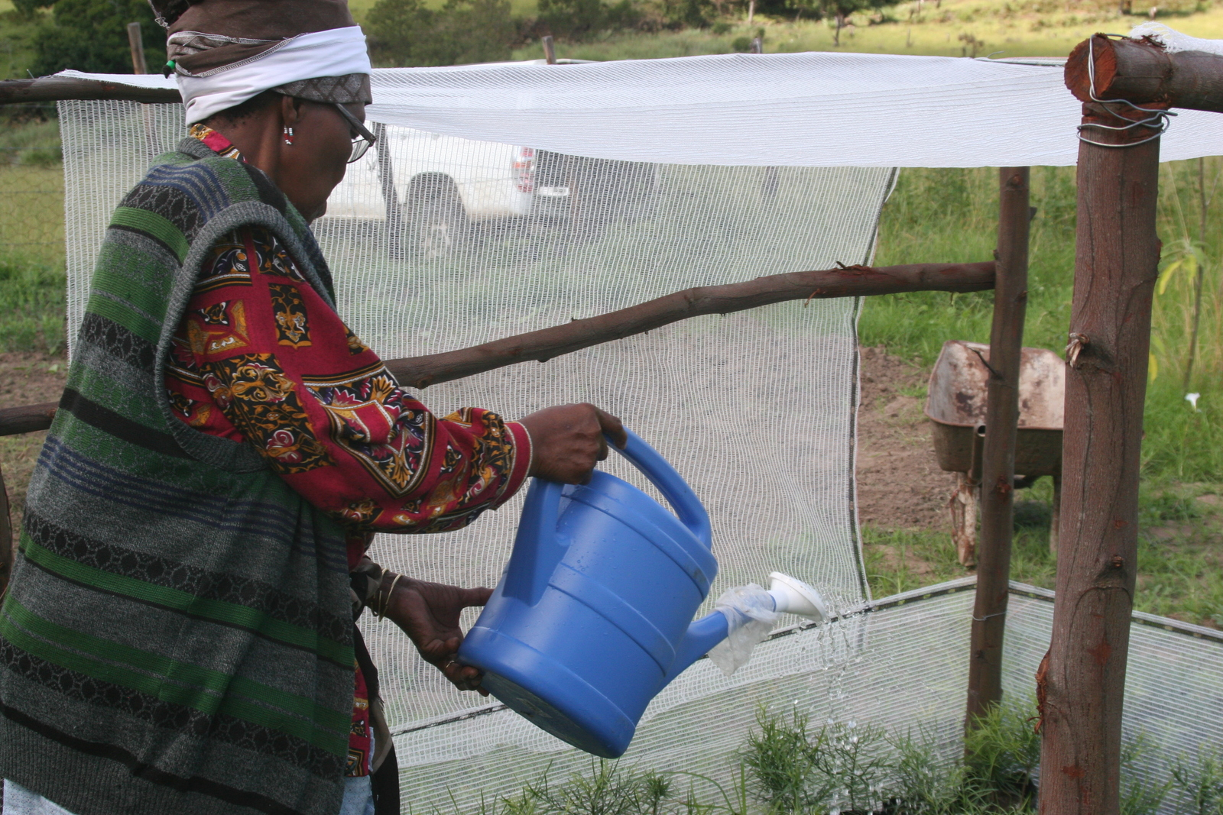
Thank you

