Slide 1

Founded in 1895 as the
New York Zoological Society

Slide 2
Conservation through science
WCS uses cutting-edge scientific research around the globe to support conservation:
  behavioral ecology
  breeding of endangered species
  conservation genetics
  molecular ecology
  landscape ecology
    remote sensing
    geographic information systems

Slide 3

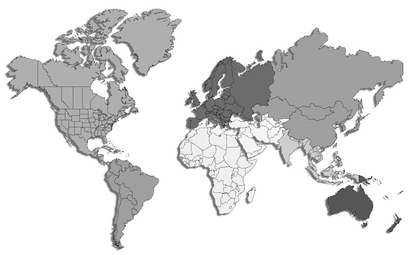
Global Health Programs

Slide 4
The role of disease in conservation
Natural role of disease in population dynamics
Anthropogenic influences have altered these dynamics
  Increasingly vulnerable populations
    Numbers, distribution, genetic pool
  Loss of natural boundaries
    Exposure to novel pathogens, vectors, hosts
  External stressors
    Habitat loss, food/water scarcity, hunting
  Pollution exposure
    Immunocompromise, run off of pharmaceuticals/pathogens
  Zoonoses
    Protective or deadly?

Slide 5
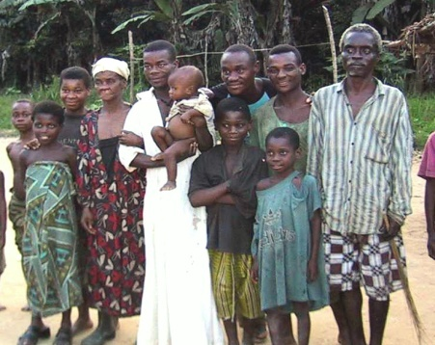
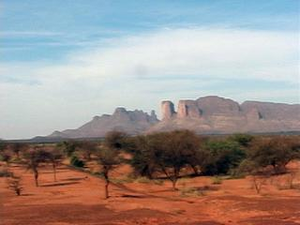
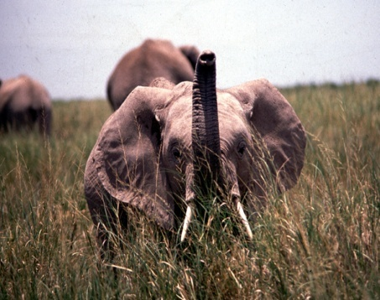
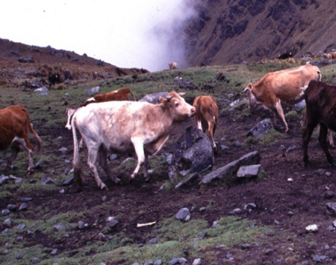
The Human, Wildlife, Livestock, Interface

Slide 6
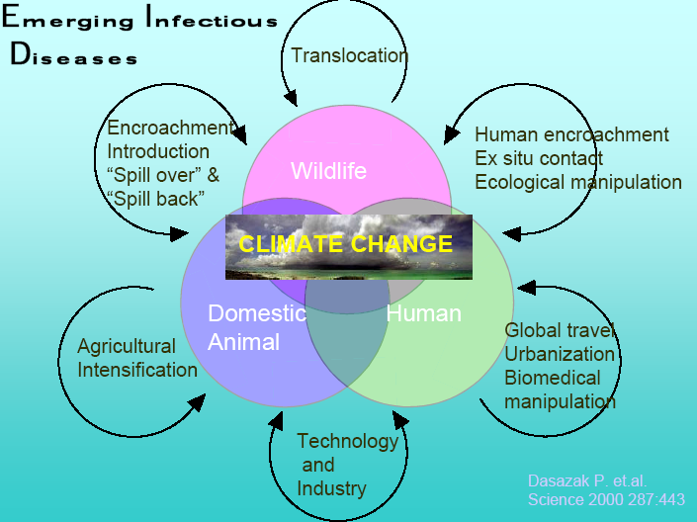

Slide 7
Human
encroachment into
natural habitats
Agricultural
practices
Population
growth
Globalization
of trade
Extensive
antibiotic use
infectious disease emergence
International
travel
Deforestation
Climate
change
Cohabitation of
agricultural species
and wildlife
Bioterrorism
= Biodiversity-related

Slide 8
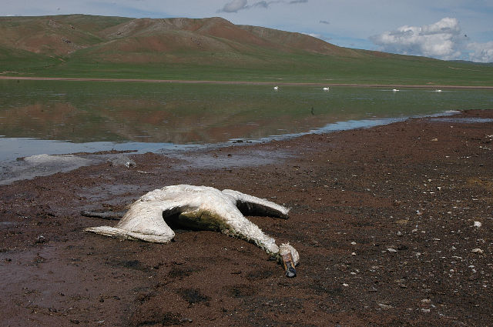
Avian Influenza
W. B. Karesh / WCS

Slide 9
Avian Influenza
Habitat encroachment
  Pathogen pollution
Legal and illegal trade
  Movement of poultry and wild birds via trade
Direct contact
  Abnormal poultry/wild bird/human contact
Climate change ?
  Limited water/habitat availability

Slide 10
Ebola Hemorrhagic Fever
The largest health threat to great apes in Central Africa
Highly infectious
  50-90% mortality
Est. 5,000 gorillas killed in 2005 epizootic
Zoonotic

Slide 11
Ebola Hemorrhagic Fever
Habitat encroachment
  Leading to vulnerable populations
  Possible vector/host dispersal?
Direct Contact
  Competition for resources
  Hunting
Legal and illegal trade
  Bushmeat and hunters spread disease

Slide 12
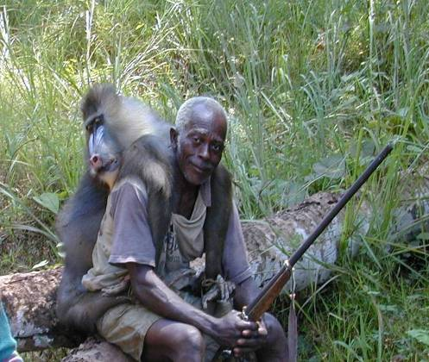
2,000,000,000 Lbs meat / year (Central Africa alone)
SIV/HIV/AIDS Paramyxovirus
Ebola STLV
Anthrax M. bovis
Echinococcus M. tuberculosis
Monkeypox Yersinia
Hepatitis Rabies
Herpes Hemorrhagic fever
Parasites Avian Influenza

Slide 13
Bovine Tuberculosis
Brought to Africa with translocation of European cattle in early 1900’s
By 1990, discovered in Buffalo in Southern Kruger National Park
Currently has been transmitted to
  Buffalo, Lion, Cheetah
  Leopard, Hyaena, Kudu, Nyala, Impala, Warthog, Bushpig, Baboon, Bushbuck, Rhino, Meerkat, Mongoose
Causes respiratory and gastrointestinal disease/wasting

Slide 14
Bovine Tuberculosis
Tanzania
(Kazwala et al. 2005)
15.9% Bovine tuberculosis
70.5% M. tuberculosis
13.6% other TB species
71% of Bovine TB cases were extra-pulmonary
28.6% of extra-pulmonary cases in total
86% HIV / TB co-infections in
South Africa
Thoen and Steele (1995)
C. Geoghegan

Slide 15
Bovine Tuberculosis
Translocation
  Movement of cattle and wildlife Habitat encroachment
Vulnerable populations/limited distribution
Habitat encroachment
  Increased cattle/wildlife interaction
Limited resources
  Pathogen contamination of water holes
Zoonosis
  Zoonoses via agriculture industry
Climate change ?
  Limited water/habitat availability

Slide 16
Other Infectious Diseases Threatening Africa
Canine Distemper
Malaria
Rift Valley Fever
Congo-Crimean HF
Trypanosomiasis
Foot-and-Mouth Disease
Rinderpest
Anthrax
Dengue Fever
many, many more…
Many of these diseases have political, cultural and economical ramifications!

Slide 17
Climate change
Hypotheses/IPCC predictions
  Increased T will expand range of vector borne diseases
  Increased flooding in some areas will result in influx of water born diseases
  Increased drought in other areas will result in increased animal contact, and interface conflict.
  Increased morbidity and mortality from heat waves, floods and droughts
  Increasing burden from malnutrition, diarrhea, cardio-respiratory and infectious diseases

Slide 18
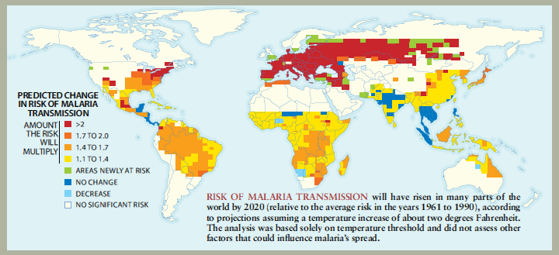
Climate change and infectious disease
From: Epstein, P. Is Global Warming Harmful to Health? Scientific American, August 2000.

Slide 19
WCS Global Health Programs: Solutions
GAINS
Great Ape Health Program
AHEAD

Slide 20


















GNAIS
Global Avian Influenza
Network for Surveillance
(GAINS) for Wild Birds

Slide 21
WCS Global Health Programs
Global Avian Influenza Network for Surveillance (GAINS)
  Tanzania, Sudan, Egypt, South Africa, Zimbabwe, Congo, Botswana, Mozambique, Nigeria
  Partners include: Wetlands International, University of Capetown, Tanzania Bird Atlas, CIRAD, FAO, local governments, veterinarians, and ornithologists

Slide 22
GAINS to Date
>36 Developing Countries
>1000 people trained
>103,000,000 birds in database and mapping system

Slide 23
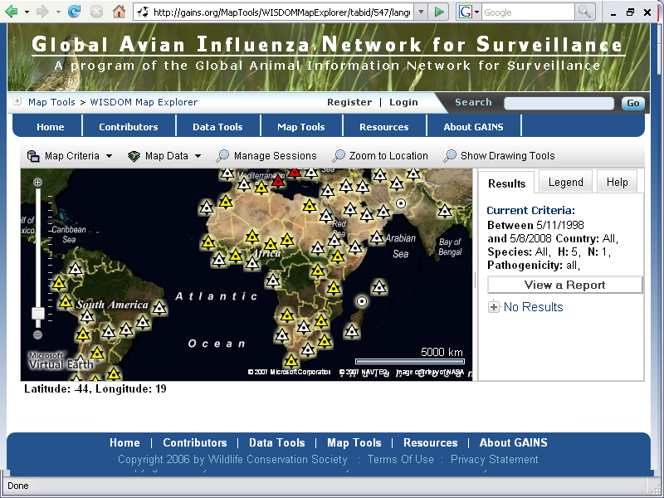

Slide 24
WCS Global Health Programs
Global Avian Influenza Network for Surveillance (GAINS)
  Encourages transdisciplinary approach to emerging infectious diseases
  Encourages open data sharing
  Encourages capacity building to respond to disease and raises awareness regarding issues such as habitat encroachment and wildlife trade.

Slide 25














Great Ape Health Program

Slide 26
C.A.R.
GABON
CONGO
D.R.C.

Slide 27
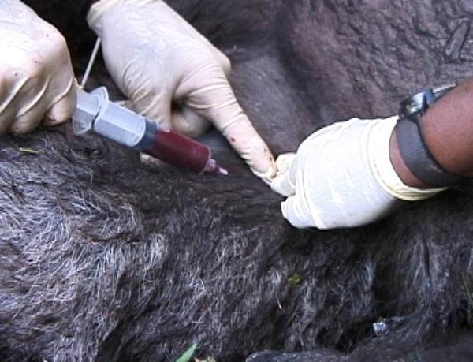
Hands-on work
Health examinations

Slide 28
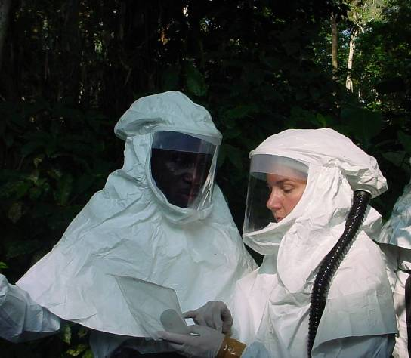
Disease outbreak
Investigations &
Post-mortem exams
W. B. Karesh / WCS

Slide 29
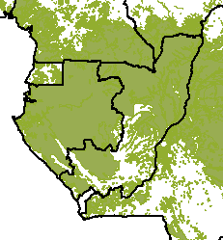

Regional Field Laboratories
    Parasitology
    Sample processing
    Exploring on-site Ebola diagnostics
    Training / capacity-building
    Community health support

Slide 30
Serology - Positives
Herpes Simplex 1
Epstein Barr
Rubella
Hepatitis A
Hepatitis B
Treponema
Data suggest animals have already been exposed
and have some immunity following exposure
Notes:
List of procedures conducted

Slide 31
Serology - Negatives
Polio
Measles
Dengue Fever
Monkey Pox
Reovirus
Parvovirus
Ebola
Data suggest animals have NOT been exposed
and have NO immunity
Notes:
List of procedures conducted

Slide 32
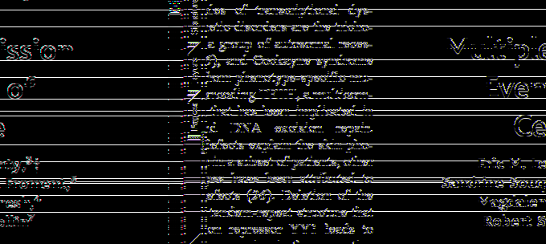
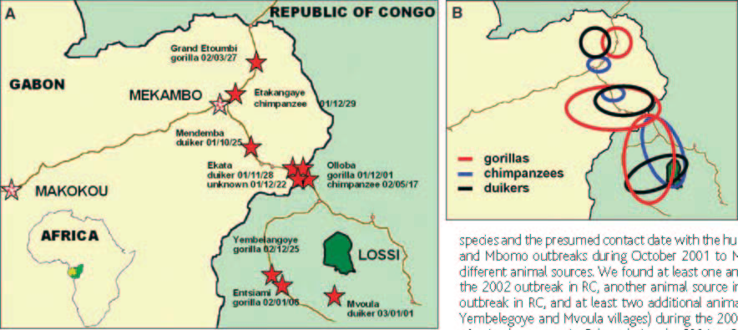
SCIENCE, Jan 16, 2004

Slide 33

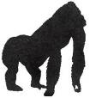


Ebola outbreak in Mbomo and Kéllé districts,
December 2002 to April 2003, Congo
(143 cases, 128 deaths)
Gorilla gorilla
Pan troglodytes
Cephalophus
Mbomo
2
30
Kelle
3/25 medical
staff infected
25
20
15
survivor
death
Brazzaville
(WHO-AFRO)
10
1
5
0
49
50
51
52
1
2
3
4
5
6
7
8
9
10
11
12
13
14
15
16
17
18
December
January
February
March
April

Slide 34
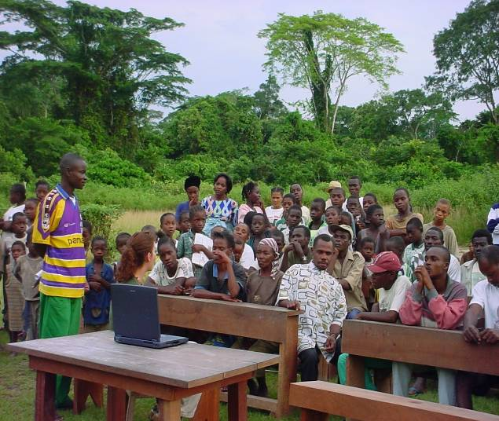

Public Education and Preparedness

Slide 35
Prevention: Ebola vaccine
Vaccine development (NIH VRC, NIH NIAID)
  Efficacy
  Safety
  Delivery
  Target populations
    Priority great ape populations
    Non-target species

Slide 36
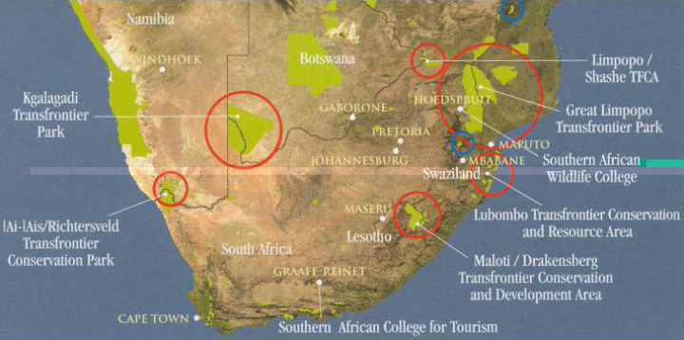
AHEAD: Animal Health for the
Environment And Development
Guiding Policy

Slide 37
AHEAD
13 existing and proposed Transfrontier Conservation Areas covering 1.2 million km of Southern Africa
Rationale dominated by ecological and tourism considerations
  Restoring free movement of large wild mammals particularly elephant
  Free movement of tourist across international borders
  Fostering cooperation between countries– Peace Parks
Concerns include spread of disease among wildlife, livestock, and wildlife; and affecting the livlihoods of agro-pastoralists living within the historically separated parks

Slide 38
Economic Impact of Selected Infectious Diseases
SARS
China, Hong Kong,
Singapore, Canada,…
$50bn+
$50bn
$40bn
$30bn
Foot & Mouth
UK
$30bn
Estimated Cost
$20bn
Swine Flu, Netherlands
$2.3bn
Avian Flu, Asia
US, Canada
$10bn
$10bn
BSE, UK
$10-13bn
Foot & Mouth
Taiwan, $5-8bn
BSE, Canada
$1.5bn
BSE, US
$3.5bn
Lyme disease
US, $2.5bn
Nipah, Malaysia
$350-400m
BSE, Japan 1.5bn
Avian Flu, EU
$500m
1992
1993
1994
1995
1996
1997
1998
1999
2000
2001
2002
2003
2004
Figures are estimates and are presented as relative size. See table for more details.
BIO-ERA

Slide 39

TM

