Slide 1
Prevention and Control of
Emerging Infectious Diseases in Africa
Karen M. Becker DVM, MPH, DACVPM
August 7, 2008

Slide 2
Livestock as an Entry Point
to Poverty Alleviation
The poor of the world in many developing countries depend heavily on animal-based agriculture for their well-being.

Slide 3
Burden of Disease on Animal and Human Livelihoods
Animal Diseases create barriers to livestock productivity and agricultural development
  Public health threats
  Decrease access to markets and trade
  Institutionalize poverty
  Threaten food security
  Threaten livelihoods
Sub-Saharan Africa: annual economic losses from animal diseases estimated to be >US$4B
  Direct and indirect losses from mortality, slow growth, low fertility, decreased work output, etc.
Notes:
3

Slide 4
Livestock 2020 –
The Next Food Revolution
Global increase and demand for protein and food of animal origin
Shift from poverty: 1-2 billion people to middle class
“Westernization” of Asia and Latin America
Increases in emerging zoonoses through the concentration of people and animals

Slide 5
Meeting the Need
Animal Human Interface
Animals as food
High density production
“Backyard flocks”
Bush meat
Nearly 12 tons per year of illegally smuggled meat (including bush meat) into UK
• Over a six month period at the beginning of 2006, US Customs officers confiscated 62 pounds of bush meat being smuggled
through a single US airport from Africa
• Evidence of repeated emergence of new
viruses similar to HIV arising from human infection with simian viruses, common among Central African bush meat hunters
Sources: Wooldridge, Hartnett et al. 2006; (US Customs and Border Protection 2006)

Slide 6
Priority Activities for Enhancing Animal Health Systems in Africa
Information Management and Communication Systems
Early Detection, Surveillance and Reporting of Priority Livestock Infectious Disease Threats
Effective and Efficient Disease
Prevention and Control
Strengthen Private and Public Partnerships
Notes:
6

Slide 7







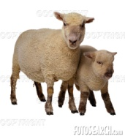

Disease Surveillance for Action
Knowledge
High Risk Places Identified
Policy/Plans for notifications
Implementation Plan
Time and places identified
Response & Mitigation
Open ARIS
Information
Interoperability
National Reporting
CVO’s Office
Mobile Application and SMS Messaging
Accessibility
Network Connectivity
Field Level – Raw Data
Decrease Production
Detection and Reporting
Decrease fertility/abortion
Illness or Death
Notes:
To send a new slide

Slide 8
Selected Emerging Infectious Disease Challenges
Hantavirus pulmonary syndrome
Plague
Ebola hemorrhagic fever
New variant Creutzfeldt-Jakob disease
Cyclospora
H5N1 influenza
Nipah virus encephalitis
West Nile virus neuroinvasive disease
Rift Valley fever
Anthrax
Vancomycin-resistant S. aureus
SARS
Monkeypox
Transplant-associated infections
Community-associated methicillin-resistant S. aureus
Poliomyelitis
Marburg hemorrhagic fever

Slide 9
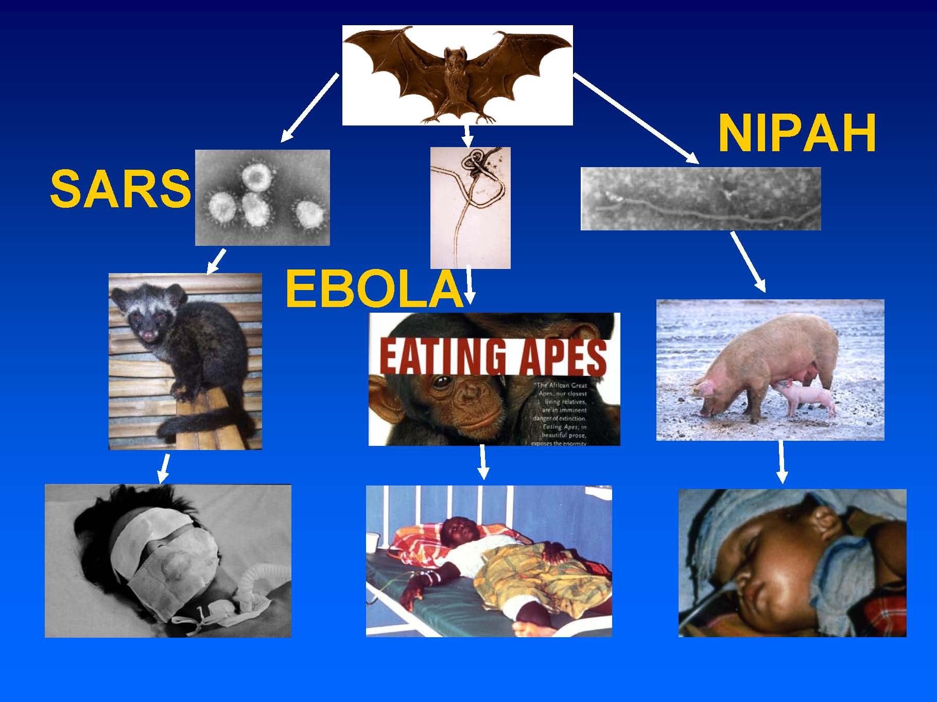

Slide 10
Why Diseases Emerge
Genetic and biological factors
  Microbial adaptation and change
  Human susceptibility to Infection
Physical environmental factors
  Climate and weather
  Economic development and land use
Ecological factors
  Changing ecosystems
  Human demographics and behavior
Social, political, and economic factors
  International Travel and commerce
  Poverty and Social inequity
  War and Famine
  Lack of political will
  Intent to harm

Slide 11
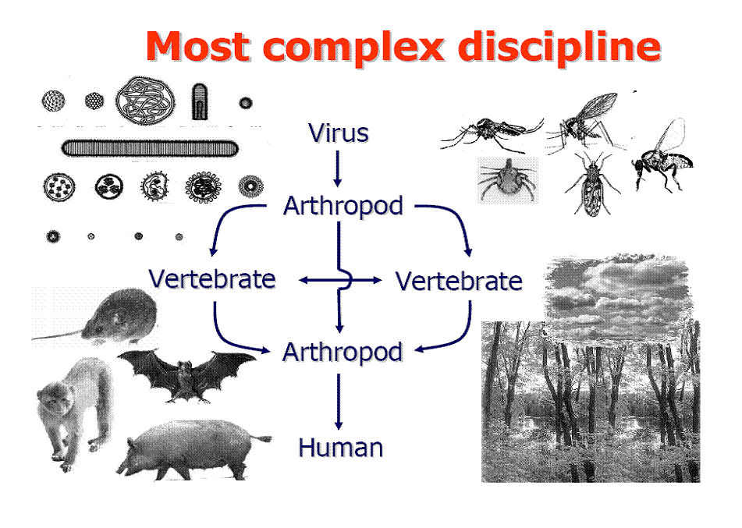
Bruce Kaplan, DVM
4748 Hamlets Grove Drive
Sarasota, Florida 34235
E-mail: bkapdvm@verizon.net
Phone/fax: 941-351-5014

Slide 12
Number and type of emerging infectious disease events by decade,
1940-2000
Helminths
Fungi
Protozoa
Viruses or prions
Bacteria or rickettsiae
Zoonotic: unspecified
Zoonotic: non-wildlife
Zoonotic: wildlife
Non-zoonotic
1940 1950 1960 1970 1980 1990 2000
1940 1950 1960 1970 1980 1990 2000
EID event = the first temporal emergence of a pathogen in a human population which was related to the increase in distribution, increase in incidence or increase in virulence or other factor which led to that pathogen being classed as an emerging disease Jones et al, Nature 21 Feb 2008

Slide 13
Timeline of Emergence of
Influenza Viruses in Humans
Avian
Influenza
H9
H7
Pandemic
vaccines
H5
H5
B
Russian
Influenza
Asian
Influenza
H1
Regular vaccines
H3
Spanish
Influenza
H2
Hong Kong
Influenza
H1
1998/9
1918
1957
1968
1977
1997
2003

Slide 14
GAO Recommendations
“Links between public and animal health agencies are becoming more important.
Address schism between the veterinary, wildlife and PH fields
Solve the legal difficulties that prevent data sharing (confidentiality)

Slide 15
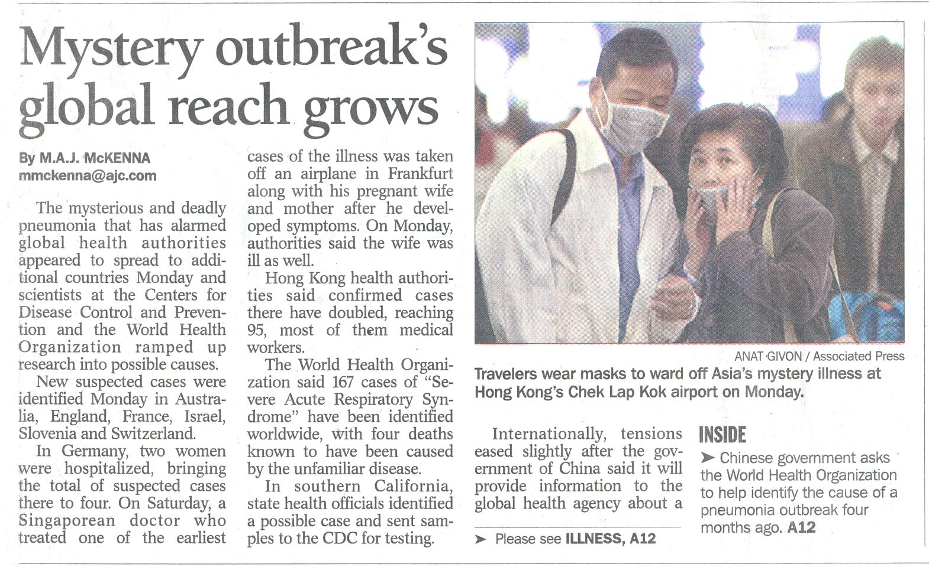
SARS: Global Outbreak…Local Impact
Local Outbreak…Global Impact…

Slide 16
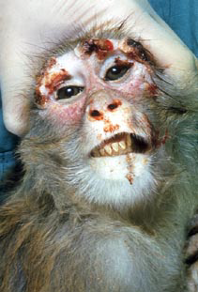
Monkeypox
First described in primate outbreak in 1958 – so named

Slide 17
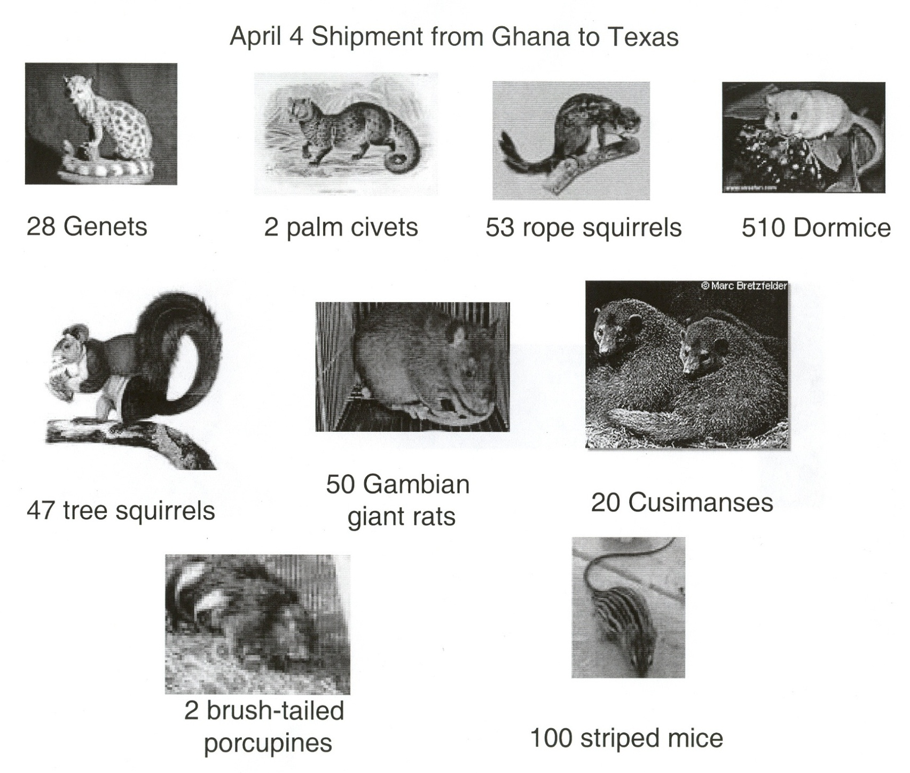

Slide 18
Movement of Imported African Rodents to Animal Distributors and Distribution of Prairie Dogs from Point of Infection
Rodent Shipment from Accra, Ghana
4/9/03
4/9/03
NJ
RS, BTP
SS
TX 1**
50 Gambian rats (GR)
53 rope squirrels (RS)
2 brush-tailed porcupines (BTP)
47 sun squirrels (SS)
100 striped mice (SM)
~510 dormice (DM)
TX 2
GR
?
WI
Human cases:
17 confirmed
22 probable/
suspect
IL‡
Human cases:
8 confirmed
4 probable/
suspect
4/11/03
TX 3
RS, SM
DM
42 PDs traced
4/16/03
14 PDs traced
IN
Human cases:
7 confirmed
9 probable/
suspect
4/17/03
IA†
GR, DM
4/21/03
IL 1§
GR, DM
24 PDs traced
TX 4
DM
TX 5
DM
200 prairie dogs (PDs)
in existing inventory
1 PDs traced
MO
Human cases:
2 confirmed
4/26/03
4/28/03
1 PD traced
?
TX 6
SS, SM
DM
TX 9
DM
11 PDs traced
SC
No human cases
4/28/03
KS
Human cases:
1 confirmed
TX 7
DM
TX 8
DM
MI
No human cases
4/29/03
TX 10
DM
5/12/03
5/18/03
IL 2
DM
6/1/03
Japan
DM
MN
DM
6/1/03
WI
DM

Slide 19
Priority Diseases to Address
Poultry
  *Avian Influenza, *New Castles Disease, Gumboro’s Disease
Ruminants, Wildlife
  *Rift Valley, PPR, *Bovine TB, East Coast Fever, CBPP, CCPP, FMD, *Brucellosis, *Trypanosomiasis, *Anthrax
Pigs
  African Swine Fever
Ruminants, Wildlife, Domestic
  *Rabies, hemorrhagic fevers
  *Zoonotic Diseases
Notes:
19

Slide 20
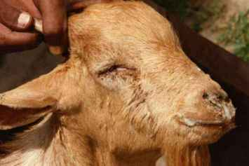
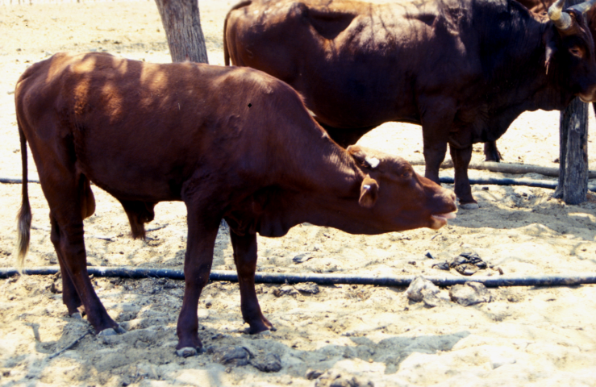
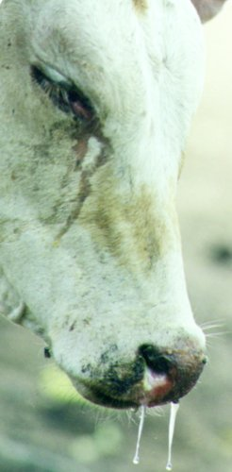
Examples of Priority Diseases
PPR
PPR
NCD
HPAI
CBPP
FMD

Slide 21
Progression of PPR outbreaks

Slide 22
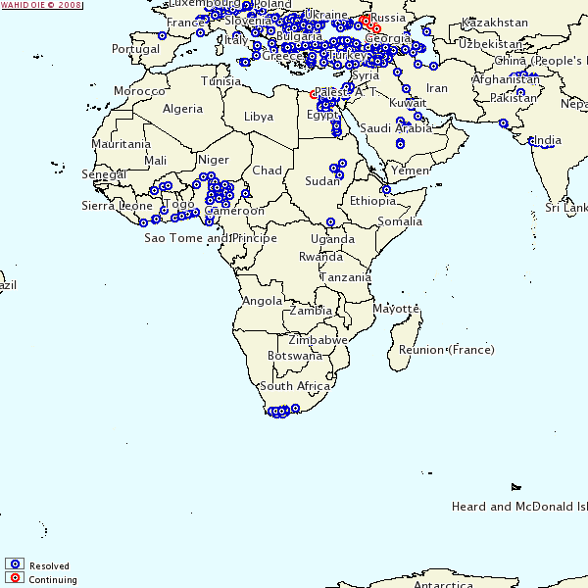
Highly Pathogenic Avian Influenza 2006-Present

Slide 23
HPAI in Nigeria
World Bank Cost Benefit Analysis
Total animal health plan cost=$4.5M/yr Strengthening disease surveillance and control = $2M
2006 epidemic estimated cost=$113M
2/3 production small holder systems
Poultry rearing central to survival of rural and urban poor
Investment in prevention=poverty alleviation and food security

Slide 24
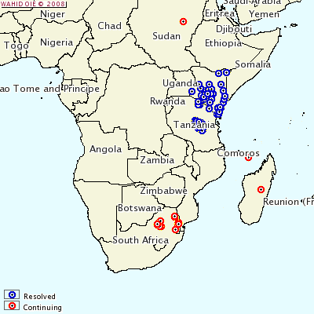
Rift Valley Fever 2005 to Present
Notes:
An epizootic of RVF affecting susceptible dairy cattle can result in abortions in up to 80% of pregnant animals with many (20-40%) deaths of calves of up to 3 months of age, 10-15% mortality may occur in animals of up to 1 year of age, with some deaths occurring in adults. The consequential losses from the abortions are considerable as milk production is drastically reduced, following the disruption of lactation patterns.
Camel herds suffer principally from abortions, when most of those pregnant may abort. This has a serious impact on the food security of the herders, for whom camel milk is major source of dietary protein.
The wool sheep, which have been imported particularly into South Africa and into Kenya and other exotic breeds introduced to improve production, are highly susceptible to RVF. The greatest impact may be seen in such flocks, where virtually all animals abort and all the young lambs die in a period of a few weeks. Many, but not all, of the indigenous sheep and goat breeds in RVF enzootic areas of sub-Saharan Africa show a degree of resistance to the virus and do not suffer in this manner. To the north however, in the Sahelian zones and in Egypt, most of the small ruminant breeds are susceptible to RVF.
The greatest overall loss produced by epizootics of RVF, results from the imposition of a total ban on livestock trade from RVF-infected areas. One of the recent RVF epizootic in the Horn of Africa was followed by the cessation of the lucrative trade in small ruminants to Arabic countries to the north and north-east. This resulted in serious economic losses of the order of 50-75 million dollars per year to the populations in the region, who were totally dependent upon this income. The first RVF epizootic in Egypt was said to have cost the livestock industry in Egypt some US $82 million in direct and indirect losses. The OIE regulations recommend the banning of livestock exports from an RVF infected country for 3 years following an outbreak. The losses due to trade ban of small ruminants, mainly sheep to Saudi Arabia particularly during religious festivals at Mecca has been estimated to be US $ 0.6 – 0.9 billion each year.

Slide 25
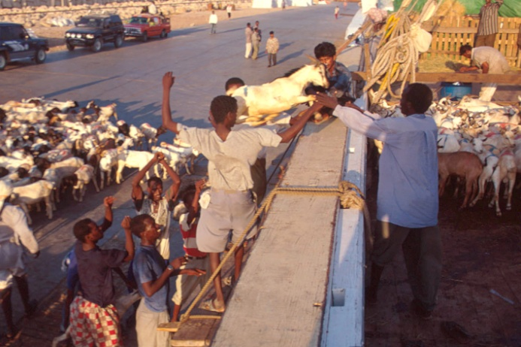
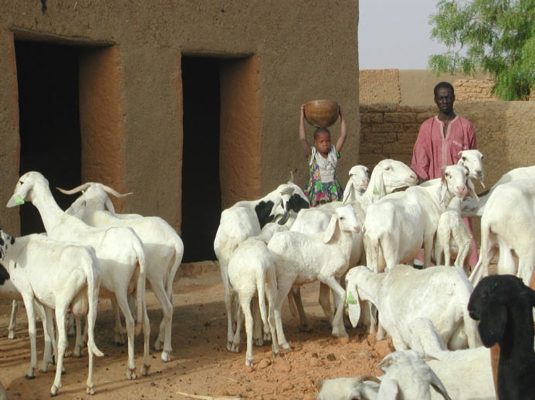
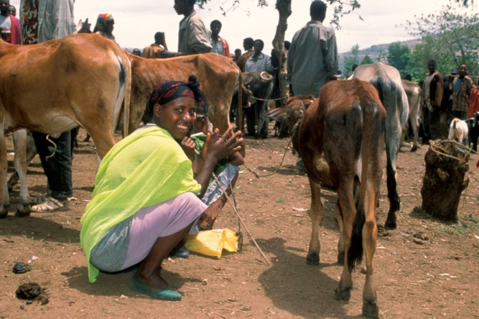
RVF Impact
Trade
Human & animal health
Livelihood

Slide 26
Bottlenecks to Control of Diseases
Low priority accorded to animal disease control efforts by governments and other institutions;
Lack of financial resources to mount sustained control programmes against animal diseases;
The loss of critical mass of capable and experienced workforce with institutional memory in animal disease control methodologies have been detrimental to sustenance of animal disease control efforts.
Experienced field staff often the frontline for epizootic disease control, suffer the ravages of HIV/AIDS.

Slide 27
Challenges for Animal Health Development in Africa Become Opportunities
Gap between progress in animal science and conversion into effective actions and policies
Divide between knowledge and application due to lack of training, infrastructure thus leaving poor surveillance and diagnostic capacity
New technologies, tools, and knowledge are important but also need, robust, resilient and transforming processes to build institutional capacity
Fragmentation of scientific disciplines
  Need more better integration and communication of knowledge, more public engagement for social relevance

Slide 28
THANK YOU!
Notes:
28

