Slide 1
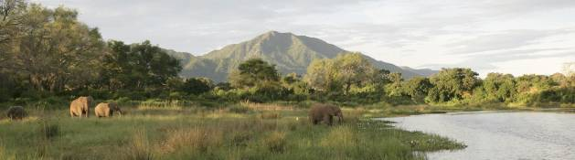
Zambia’s First Partnership Park:
A Model for Africa’s Protected Areas
Alternatives to Extractive Industry

Slide 2
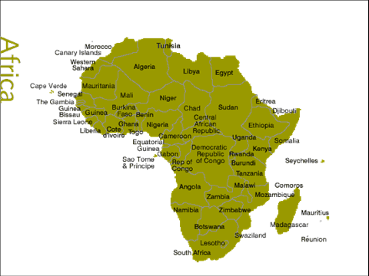

Slide 3
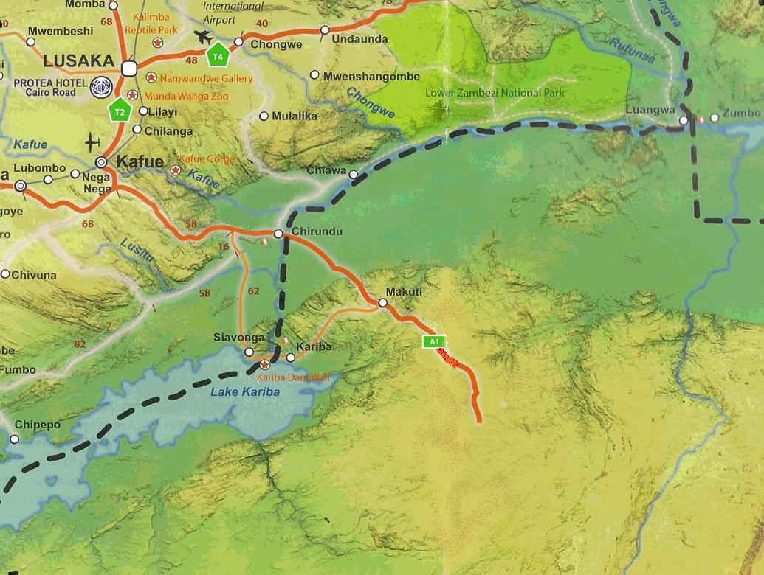
Lower Zambezi National Park
Eastern GMA / CPP
MOZAMBIQUE
Western GMA
ZAMBIA
ZIMBABWE

Slide 4
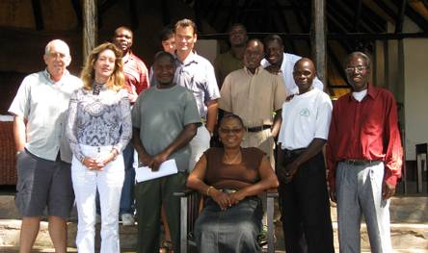
Chiawa Partnership Park
UNDP /
Lower Zambezi Conservation Trust (Community and Leaseholders) /
Zambia Wildlife Authority

Slide 5
Why It’s Different:
Cooperation & partnership between all sectors: government / private sector / community
Genuine community ownership & empowerment
Accountability
Longevity

Slide 6
OVERVIEW:
The Lower Zambezi catchment basin is the 3rd largest water catchment area in Africa, and serves the needs of almost one million people in 3 countries as well as harboring immense wildlife populations
Exploratory mining projects within the area: open pit copper and uranium mining, cyanide gold mining
Concern from Zambia’s local traditional chiefs and residents, leaseholders, independent sustainable industries and domestic and international conservation organizations
Potential threat by extractive industry exploration/development within protected wilderness areas
Targeted exploratory mining areas: Lower Zambezi National Park and Zambia’s first Partnership Park

Slide 7
OVERVIEW (cont):
Possible impacts on Mana Pools National Park, a renowned World Heritage Site located directly across the Zambezi in neighboring Zimbabwe.
Possible threats to human and wildlife populations.
Fragile and easily eroded environment prone to sporadic, extremely heavy rains makes the area high risk for spills and contaminant release into the river.
Projects are located within category I-IV protected areas and within close proximity to the UNESCO World Heritage Site, all of which fall under recommendations by the International Union for Conservation of Nature (IUCN) as “No Go” areas for exploration and development of extractive mining industries.
Standards, implementation and availability of environmental impact assessments.

Slide 8
OVERVIEW (cont):
In 2008 just after the Zambian government passed the new Mining Act allowing for mining in protected areas, the International Atomic Energy Commission approved mining of uranium within the country. Omega Corpartion’s internet stakeholder reports project that uranium production will commence by 2011, on the shores of Lake Kariba.
Community leaders have publicly expressed concerns about the effects of possible contamination by uranium waste by-products which may already be occurring during the exploration stage. Full environmental impact assessments (EIAs) are not required until after completion of the current exploration stage activities.
According to international law all persons must be moved within a 50 mile radius of open pit uranium mining. This could involve over 100,000 people.
Short term benefit from extractive industry at what cost to the future?
As a unique and world-renowned ecosystem with immense financial and ecological value to Zambia and its neighboring countries, the area deserves the highest level of protection.

Slide 9
BACKGROUND INFORMATION:
Proposed Mining Operations
PUBLIC SHAREHOLDER REPORTS FROM THE VESTED INTERNATIONAL MINING CORPORATIONS, PRIMARILY HEAD QUARTERED IN AUSTRALIA, INDICATE THAT DEPOSITS OF TARGET METALS HAVE BEEN FOUND IN THE EXPLORATORY SITES IN SUFFICIENT QUANTITIES TO DEMONSTRATE POSITIVE ECONOMICS FOR MINING.
COMPANIES LEADING OR PARTNERING IN THE CURRENT EXPLORATIONS INCLUDE:
ZAMBEZI RESOURCES LTD, OMEGA CORPORATION, ALBIDON MINING AND AFRICAN ENERGY RESOURCES, GLENCORE INTERNATIONAL OF SWITZERLAND, LITHIC METALS AND ENERGY, RIO TINTO ZINC, ASTRON LTD. (NEW POTENTIAL INVESTOR).
  The Kangaluwi Copper/Gold Project, located inside the Lower Zambezi National Park (LZNP). This project is currently 100% owned by Zambezi Resources and is the site of rapidly expanding exploration, including a major resource drill out project during 2008/ 2009. It is reported by the exploration company to be a “world class open pit copper deposit¹” and a “company-making project²”. Astron Ltd could be new investor in this project. Aston is considering investing.

Slide 10
BACKGROUND INFORMATION:
Proposed Mining Operations
  Located in the Chiawa Game Management Area (GMA) soon to be re-classified as Zambia’s first Partnership Park, is the Cheowa Copper/Gold Project. This project is a joint venture between Zambezi Resources and Glencore International (now combined with the Chongwe Copper Belt Project³). The Chumbwe and Mpande areas, also located in the Chiawa GMA, are included in a uranium joint venture between Zambezi Resources and Lithic Metals and Energy, along with their Mulungushi and Rufunsa licences⁴.
  The Mulofwe Project, located in the river catchment above the Chiawa GMA and Lower Zambezi National Park, is an exploratory uranium joint venture project from a partnership between Zambezi Resources and Rio Tinto Zinc⁵.
  A fourth area of great concern is the uranium project in Siavonga. The project is in the exploration stage by Zambezi Resources and in more advanced stages by Omega Corporation. This project is located in the catchment area directly above Lake Kariba, the largest single water source in Southern Africa second only to Lake Malawi.

Slide 11
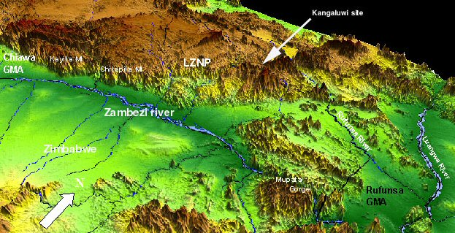
FIGURE 1. GENERAL LOCATION OF PROPOSED MINING AREA IN ZAMBIA.

Slide 12
AREAS OF CONCERN:
Socio-Economic and Health Implications
  The Lower Zambezi Basin is a large catchment area which is bordered by Zambia, Zimbabwe and Mozambique. It supports a cross-border human population estimated conservatively at over 800,000 people, approximately 320,000 of whom live on the Zambian side.
  Pollution resulting from uranium or copper mining and other mining activities could potentially affect populations living in all three countries.
  Potential contamination of soils, groundwater, surface runoff and alluvial systems from mining activities poses a serious risk to the sustainable industries, including: subsistence farming and fishing, large scale commercial industries of high economic value such as commercial fisheries, agriculture, and safari tourism enterprises.
  Mining utilizes a finite resource, has relatively short term viability and accidents or post-mining impacts could be of sufficient scope as to render sustainable industries unviable. Additionally, the great majority of profit from the unsustainable mining industry will primarily benefit foreign investors.

Slide 13
AREAS OF CONCERN:
Socio-Economic and Health Implications (cont)
  Conflict of interest between sustainable and non-sustainable industries:
  Mining operations in the area are likely to employ a few hundred local people at each mine site who will be employed as unskilled manual labor; the uranium mine in Siavonga gives a best estimate of employing only 500 people in total, including foreign employees, and estimates for local employment at the copper mines in the GMA and Park are 100-200 maximum per site. Skilled workers will be brought in from other areas or countries.
  Most of the mines are estimated to have a lifespan of approximately ten years.
  Local long-term sustainable industries that could be impacted by environmental contamination and other associated effects include:
  Agriculture and animal husbandry, which commercially employs over 1,100 people in the Lower Zambezi area, plus approximately 3,000 seasonal workers. Many thousands of local people rely heavily on subsistence agriculture in the Lower Zambezi and Lake Kariba area alone.
  Tourism, which employs over 1,000 people in the Lower Zambezi and Lake Kariba areas in Zambia, plus several hundred on the Zimbabwe side of the Lake. Tourism is in the top three economic sectors for Zambia and has undergone rapid growth in the last five years²⁴. 25 lodges currently operate in the Lower Zambezi area alone, excluding Lake Kariba.
  Fisheries: There are three commercial fish farm operations at risk on Lake Kariba. However the majority of fishery employment is artisanal (traditional) rather than industrial and there are at least 98 registered kapenta fishery operators on the Lake, plus over 2,000 fishermen using dugouts and nets in the Western GMA of the Lower Zambezi and Lake Kariba areas.

Slide 14
AREAS OF CONCERN:
Socio-Economic and Health Implications (cont)
  Health Risks.
  There are obvious, well established human health concerns arising from acid and heavy metal contamination, which are increased by heavy rainfall. The broader effects of Acid Mine Drainage are explained in Section 2 below. The proposed uranium mines have additional associated severe health risks.
  Risks Include:
  radiation poisoning
  contamination of airborne dust
  transport of radon and other radio-nuclides through surface water resulting in ingestion and bioaccumulation in plants, animals and humans near the site;
  bioaccumulation by aquatic species from contaminated runoff.
  cancer
  respiratory effects
  organ damage²¹.
  perception alone could damage both the agriculture and tourism industries

Slide 15
AREAS OF CONCERN:
Related Environmental Impact Concerns
  Acids and Toxins: Copper mining utilizes large containment ponds, which become permanent lakes, for management of tailings which are both acidic and toxic. Containment of toxins in the proposed highly sensitive areas will be extremely difficult because the mining sites are located in an erosive environment near the river and elevated in the water catchment. Even if tailings are processed off site there are significant risks of contamination.
  Deforestation: Deforestation and charcoal production has increased due to road upgrades for exploratory site access, and this is likely to increase in scale as mining exploration and development continues. Of greater concern is that open pit mining by its very nature will entail large scale deforestation since it removes all surface materials and generally expands until the resource being mined runs out. With best practice environmental management standards in place, deforestation and removing surface soil and rock in the steep escarpment area is still highly likely to increase instability, erosion, siltation of tributaries and the main river, and result in toxic water pollution. Any rehabilitation efforts post-mining could be compromised by the steep nature of the terrain being difficult to stabilize and re-vegetate.
  Impact on Wildlife Populations: Creation of roads facilitating human and mechanical traffic into the protected areas will inevitably impact the wilderness value of the area. It should be noted that since the inception of the mining exploration and consequent building of new roads into the area, commercial elephant poaching has more than doubled.

Slide 16
AREAS OF CONCERN:
Violation of International Agreements against Mining in Protected Areas
  The proposed mining areas lie within the terrestrial eco-region of Zambezi and Mopane Woodlands which supports some of the most significant wildlife populations in Africa⁶.
  Elephant and buffalo populations are particularly healthy.
  More specifically the region contains the Middle Zambezi-Luangwa freshwater eco-region between Kariba and Cahora Bassa damns⁷, and downstream from Cahora Bassa through Mozambique to the Indian Ocean is designated as the Lower Zambezi freshwater eco-region⁸.
  Directly across the Zambezi River from the mine sites, in the same water-catchment, lies the World Heritage site of Mana Pools National Park.
  In accordance with IUCN recommendations, the International Council for Mines and Metals (ICMM) has undertaken “not to explore or mine in World Heritage properties. All possible steps will be taken to ensure that existing operations in World Heritage properties as well as existing and future operations adjacent to World Heritage properties are not incompatible with the outstanding universal value for which these properties are listed and do not put the integrity of these properties at risk” ⁹. The proximity of the mines to the World Heritage Site elevates the level of concern from a local to an international issue.
  In 2000 the IUCN put forward recommendations that governments should forbid mining in Category 1-IV Protected Areas¹⁰. The Lower Zambezi National Park, and the affected GMAs, fall under the 1-IV category¹¹. The ICMM has also acknowledged that exploration and mining may be incompatible with the objectives for which these areas are designated for protection⁹.

Slide 17
AREAS OF CONCERN:
International Conservation Relevance
  The known IUCN Red Listed species occurring inside the potential mining impact area are listed in Table 1 below²². The table includes only the species which are listed under IUCN “threatened” species categories, all of which already face a high to extremely high risk of extinction in the wild; i.e. those that are critically endangered (CR), endangered (EN) or vulnerable (VU).
  Table 1. Known IUCN Red Listed species occurring in the Lower Zambezi area.
Common Name | Scientific Name | Red List category and criteria (ver 3.1 2001)
Kariba tilapia | Oreochromis mortimer | CR A2ae
African wild dog | Lycaon pictus | EN C2a(i)
Marsh Mongoose | Herpestes palustris | EN B1+2abcd
African lion | Panthera leo | VU A2abcd
Common Hippopotamus | Hippopotamus amphibious | VU A4cd
African elephant | Loxodonta africana | VU A2a
Lappet-faced vulture | Torgos tracheliotos | VU C2a(ii)
White-headed vulture | Trigonoceps occipitalis | VU C2a(ii)
Harrison's Fruit bat | Lissonycteris goliath | VU A3c +4c
Threespot tilapia | Oreochromis andersonii | VU A3e
  Additionally, the Lower Zambezi National Park and adjacent protected areas support over 40 species of fish⁸ and more than 400 bird species, with 12 bird species of global conservation concern²³. Many other unidentified endangered species may well reside in the area. Limited data.

Slide 18
CONCLUSION:
  The ZAWA Act clearly states that no mining right be granted that does not take into account the need to conserve and protect “the air, water, soil, flora, fauna, fish, fisheries and scenic attractions in or on the land”. All of these assets can be adversely impacted by the proposed mining operations.
  Contaminants may be created during the exploratory phase, prior to the EIA being undertaken or submitted, and concerned that Pre-Feasability Studies and Bankable Feasability Studies are not being made available to concerned parties.
  Clearly mining is an essential component of the economic development of Zambia, but also clear is that it is not the industry of choice in all areas and that special areas require special consideration.

Slide 19
REQUESTS:
  copies of any baseline or feasibility studies already completed by the mining companies and submitted to the Environmental Council of Zambia be made available to concerned parties; if they are not available that they be conducted and made available before further exploration is undertaken,
  the ECZ and other internationally recognized authorities identified are allowed access to the exploration sites to assess the potential impacts exploration may have already caused, and evaluate the environmental standards of the current exploratory procedures,
  all further mining exploration and expansions are temporarily put on hold until the above requests are undertaken,
  before any agreements or contracts are granted to undertake actual mining operations an EIA be carried out by an internationally recognized and creditable independent party, to be assigned by a committee made up of the ECZ, ZAWA, and assigned experts nominated by globally recognized conservation authorities
  the EIA is completed and submitted for evaluation by the same consortium of experts before acceptance.

Slide 20
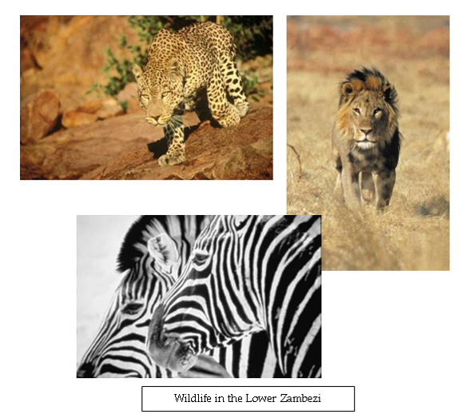
REQUESTS:
  We also respectfully request that the Government of Zambia take into consideration formal legislation for protection of high value natural heritage areas in accordance with IUCN recommendations, and restrict unsustainable developments in these high priority areas.

Slide 21






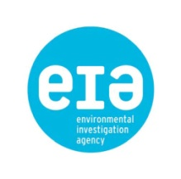
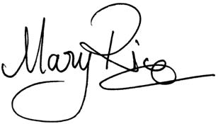
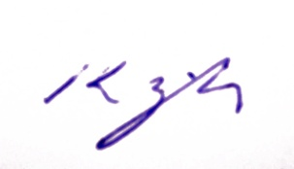
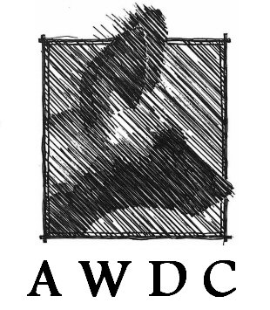








SIGNATORIES TO LETTER OF CONCERN
James Deutsch, Director – Africa Program, Wildlife Conservation Society
Rebecca Adamson, Founder/President, First Peoples Worldwide
Alec Marr, Executive Director, The Wilderness Society- Australia
Rachel McRobb, CEO,
South Luangwa Conservation Society
Mary Rice, Executive Director, Environmental Investigation Agency
Dr Kellie Leigh, Trustee/Founder
African Wild Dog Conservation, Eastern Zambia
Ian Player, Founder, Wilderness Foundation
T W Featherby, Chairman,
Chiawa Leaseholders Association
Greg Carr, Founder/ President, The Carr Foundation
Adrian Coley, Chairman, Luangwa Safaris Association
Vance Martin, President, The Wild Foundation
Singleton Rankin, Founder/ President, World Women Work

Slide 22
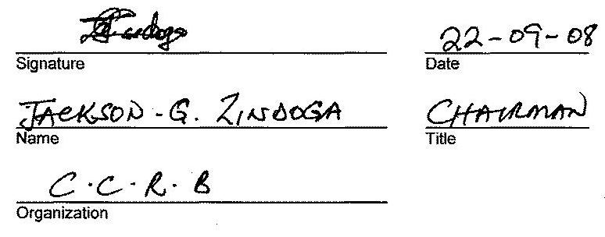
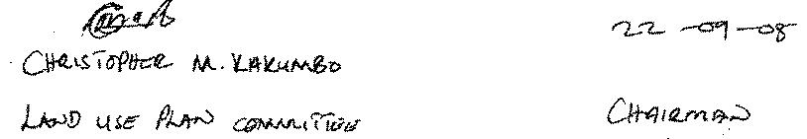
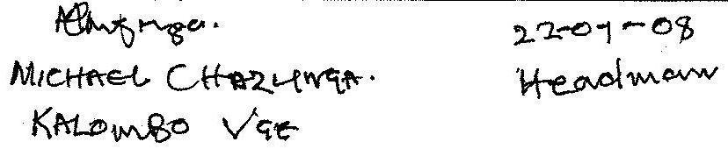

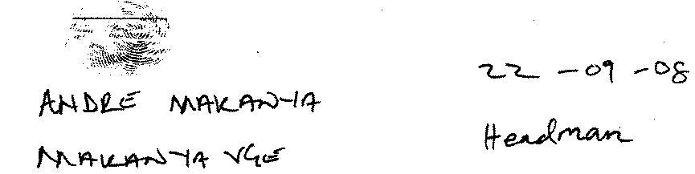
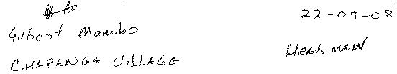
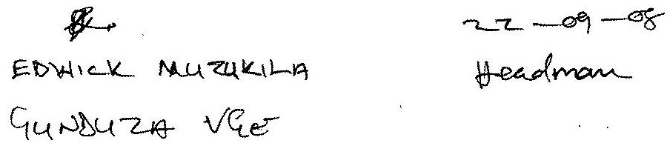
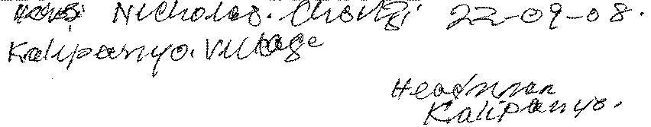
CHIAWA COMMUNITY LEADERS AND HEADMEN
Page 1
We, the undersigned, support the “Letter of Concern: Mining in the Lower Zambezi River Water Catchment and Protected Areas.”

Slide 23
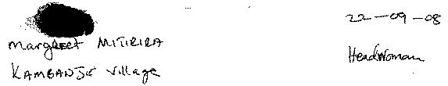
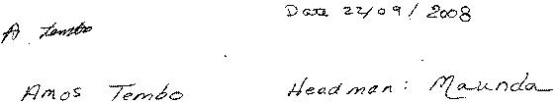
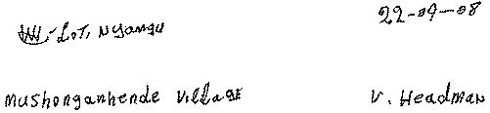
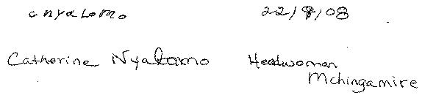
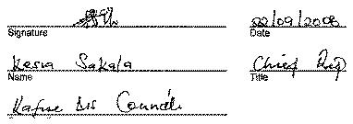
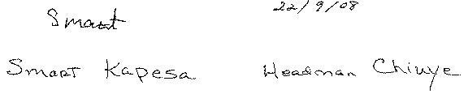
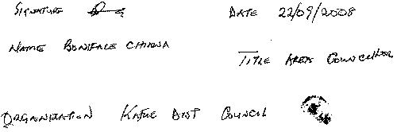
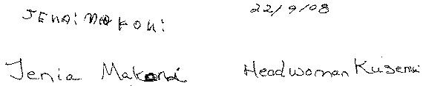
CHIAWA COMMUNITY LEADERS AND HEADMEN
Page 2
We, the undersigned, support the “Letter of Concern: Mining in the Lower Zambezi River Water Catchment and Protected Areas.”

Slide 24
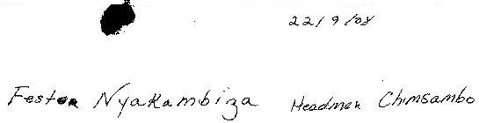
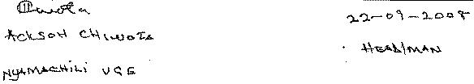
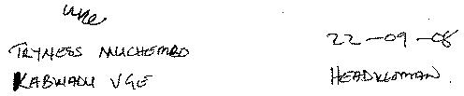
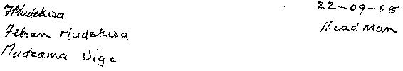
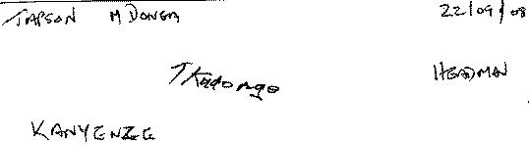
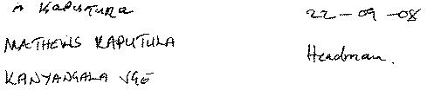
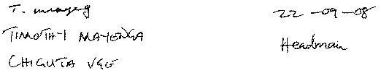

CHIAWA COMMUNITY LEADERS AND HEADMEN
Page 3
We, the undersigned, support the “Letter of Concern: Mining in the Lower Zambezi River Water Catchment and Protected Areas.”

Slide 25
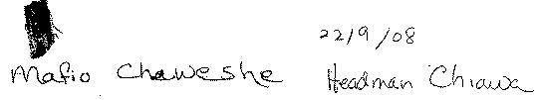
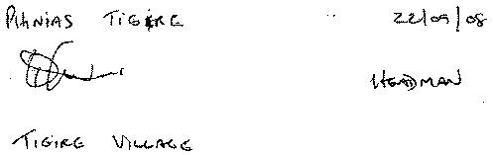
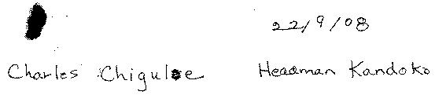
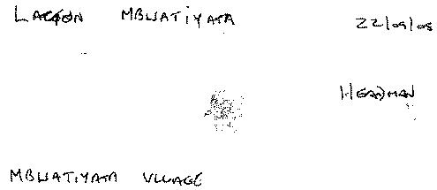
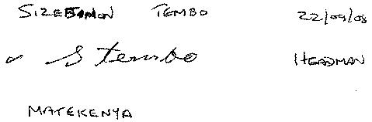
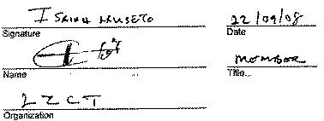
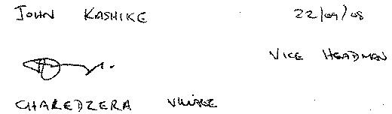
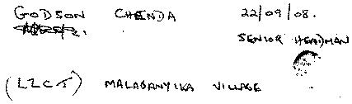
CHIAWA COMMUNITY LEADERS AND HEADMEN
Page 4
We, the undersigned, support the “Letter of Concern: Mining in the Lower Zambezi River Water Catchment and Protected Areas.”

Slide 26
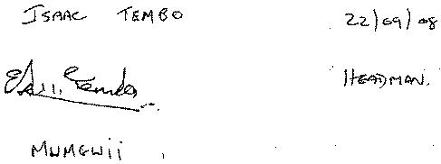
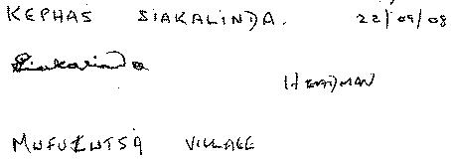
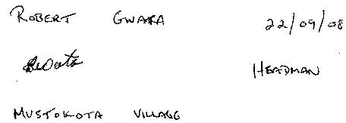
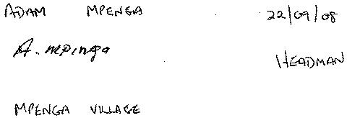
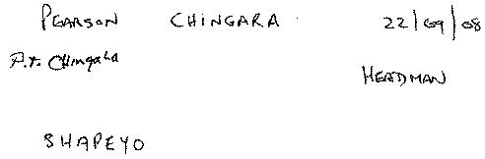
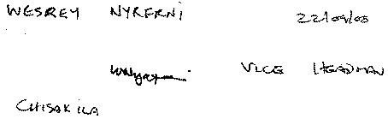
CHIAWA COMMUNITY LEADERS AND HEADMEN
Page 5
We, the undersigned, support the “Letter of Concern: Mining in the Lower Zambezi River Water Catchment and Protected Areas.”

Slide 27
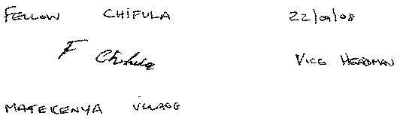
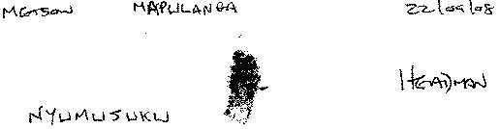
CHIAWA COMMUNITY LEADERS AND HEADMEN
Page 6
We, the undersigned, support the “Letter of Concern: Mining in the Lower Zambezi River Water Catchment and Protected Areas.”

Slide 28
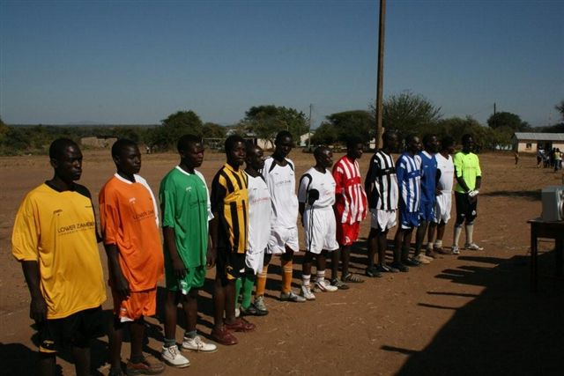
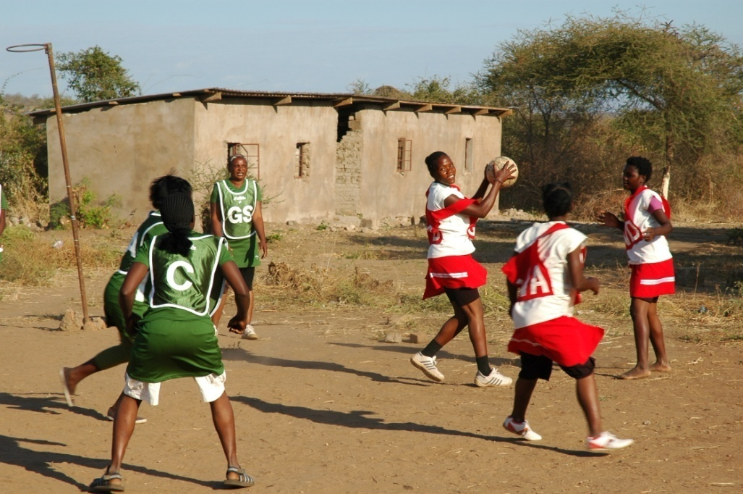
Play For Life
Sports League
51 teams in 9 villages
Play for Life – Soccer Team Captains

Slide 29


Women's Crafts Projects
Women in Mshonganende using their new Singer sewing machine
The first bag completed by the women of Mshonganende village

Slide 30


Slide 31


Slide 32


Slide 33


Slide 34



Slide 35


Slide 36


